Slide 1
Results so far – Work Package 1
Bernard Pauly
WP1 Leader / TR6
ASCOS UG2 Meeting
19 September 2013, Arona, Italy

Slide 2
Background
Need for improvement of existing certification processes already identified in FAA Commercial Airplane Certification Process Study
  There is no reliable process to ensure that assumptions made in the design and certification safety assessment are valid for operation and maintenance activities
  Human operators may not be aware of assumptions made in safety assessments, when developing their operations and maintenance procedures
  Aircraft certification standards may not reflect the actual operating environment
Future ’emerging risks’ unknown today may need to be addressed
Current certification processes may take too long or turn out to be inadequate

Slide 3
Total aviation system and the involved stakeholders

Slide 4
WP1 Objectives/ Context/ Inputs
To analyse the existing European certification and rulemaking process and propose potential adaptations to ease certification of safety enhancement systems & operations
The scope is the Total Aviation System with their stakeholders
The considered inputs are not only European (EASA, Eurocontrol…) but also worldwide (ICAO, FAA)
The on-going tasks of WP1 are organised according to the following structure:
  WP1.1 (deliverable D1.1) focused on analysis of the existing regulations and certification processes with identification of potential shortcomings and bottlenecks.
  WP1.2 (deliverable D1.2) dedicated to proposal and assessment of options in terms of “certification” potentially applicable to the different domains (airworthiness, operations, ATM, ….)
  WP1.3 (deliverable D1.3) is focused on the selection and development of the most promising approach(es)
  WP1.4 (deliverable D1.4) is dedicated to the elaboration of an ASCOS e-learning environment

Slide 5
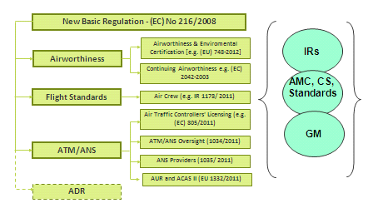
WP1.1 Objectives/ Scope
In the context of the analysis the term shortcoming is used to describe the situation where the regulation is fully implemented but proves to be inadequate.
A bottleneck is “a phenomenon where the performance or capacity of an entire system is limited by a single or limited number of components or resources”. In the context of the analysis the term bottleneck is used to describe the situation where the regulation is not implemented at the expected level.

Slide 6
WP1.1 Potential influence of Regulation on safety occurrences: assumptions
Shortcoming & bottleneck are considered from safety « performance » point of view:
  In terms of consequences: what kind of safety occurrences scenarios we need to consider in priority?
  In terms of causes: what kind of regulatory material are supposed to cover selected safety occurrences scenarios?
The main assumptions are:
  If the involved regulation by selected safety occurrences scenario is well implemented then this regulation is potentially inappropriate (in this case it’s more « shortcoming » aspect to be considered)
  If the involved regulation covering selected safety occurrences scenario is not well implemented then there is doubt about its applicability and it may be a « bottleneck » to be considered (however to be confirmed by lessons learnt)
Safety Occurrence scenario classification is combining Severity Class of Safety Event (Accident, major/ minor Incident) and annual evolution of occurrences so far (improvement or stagnation)

Slide 7
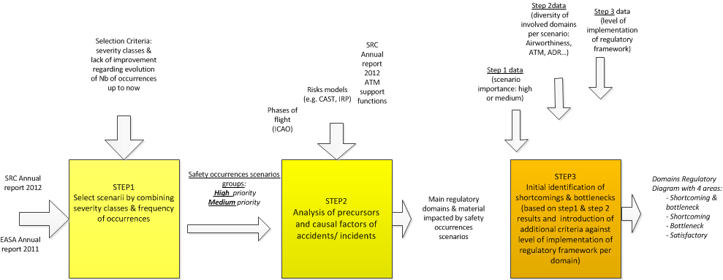
WP1.1 Overview of the approach: initial steps

Slide 8
WP1.1 STEP 1 Select Safety occurrences scenarios
Apply following criteria for safety occurrences scenarios classification
  (criteria N° 1) --> consider the severity of safety occurrences: accident, serious incident (severity A),
  (criteria N° 2) --> consider the quantitative evolution of these occurrences (select occurrences categories if there is no improvement for recent years (e.g. number of occurrences absolute or relative),
  select scenarios and related occurrences types in order to assess their importance (high, medium) by combining criteria N°1 and criteria N° 2 according to the following rules:
    Importance of scenario High --> if criteria N°1(OK) AND criteria N°2 (OK),
    Importance of scenario Medium --> if criteria N°1 (OK) OR criteria N°2 (OK),

Slide 9
WP1.1(Step 1) Example of results (scenario “High priority”)
Importance of scenario | Accident/ Incident | Sources | Comments
High | LOC-I (Loss Of Control in Flight) | EASA Annual safety review 2011 | 2002-2011 Highest number of fatal accidents in the decade for CAT (Commercial Air Transport) Figure 6 Annual proportion from all accidents in percentage of LOC-I accidents is increasing from 2008 Figure 7
High | CFIT (Controlled Flight Into Terrain) | EASA Annual safety review 2011 Figure 6 | 2002-2011 Highest number of fatal accidents in the decade for CAT (Commercial Air Transport)
High | RE (Runway Excursion) | EASA Annual safety review 2011 [Figure 8 & Figure 9] | Runway Excursions: no real improvement from 2007 for Accidents (phases of flight landing & take-off) increase of incidents from 2008 (partially due to improvement of safety occurrences reporting): phases of flight landing & taxi

Slide 10
WP1.1 (Step 1) Example of results (scenario “Medium priority”)
Importance of scenario | Accident/ Incident | Sources | Comments
Medium | CLR (aircraft deviation of ATC clearance including Level Bust) | EASA Annual safety review 2011 Figure 11 & Figure 12 SRC Annual report 2012[Figure 14] | Many of these incidents are also categorised as SMI (in the causal chain) An improvement is needed - increased number of safety occurrences not classified in terms of severity.
Medium | RI (Runway Incursion) | EASA Annual safety review 2011 Figure 11 & Figure 12 SRC Annual report 2012 [Figure 14] | Occurrence rate increases in 2010 (although an improvement in 2011: 23 serious in 2011 compared to 22 in 2010 and 62 major in 2011 to 77 in 2010) An improvement is needed - increased number of safety occurrences not classified in terms of severity.
Medium | IS (Inadequate Separation) | SRC Annual report 2012 Figure 14 | An improvement is needed - increased number of safety occurrences not classified in terms of severity.

Slide 11
WP1.1 (Step 2) Analysis of precursors and causal factors
STEP 2 Based on selected set of safety occurrences, identify related main involved regulatory material:
  describe safety occurrences in more details,
  identify potential precursors and related causes according to the previous set of selected scenarios and related safety occurrences, [use some inputs from Accident/ Incident models (e.g. CAST, IRP)] in order to highlight involved operations & systems
  consider occurrences figures related to ATM support functions [5] (SRC Annual report 2012)
  consider phases of flight related to safety occurrences scenarios,
  identify level of contribution of each regulatory domain
  The expected outputs should be the list of involved regulatory material consolidated with the related phases of flights, the list of main precursors (and potential causes if possible)

Slide 12
WP1.1(Step 2) Analysis of precursors and causal factors: examples
Importance of scenario | Accident/ Incident | Main Precursors -causes (operations & systems)
High | LOC-I (Loss Of Control in Flight) | Pilot induced Icing related events Aircraft System component failure Degraded visual environment IMC (Instrument Meteo Control)
High | CFIT (Controlled Flight Into Terrain) | Pilot trajectory deviation (use incorrect data, wrong altimeter data setting, misjudgement) FMS/ RNAV/ Flight Control Management: * instrument display wrong data * flight director error * autopilot error * airborne altimeter error * Navaid error causes deviation * landing signal error causes deviation (MLS/ ILS) * GBAS error causes deviation ATC Flight trajectory management * inadequate communication with crew * altimeter setting sent by ATC * ATCO coordination

Slide 13
WP1.1(Step 2) Analysis of precursors and causal factors: examples
Importance of scenario | Accident/ Incident | Main Precursors -causes (operations & systems)
High | CFIT (Controlled Flight Into Terrain) | * ATCO instruction (misjudgement of terrain separation) * no radar surveillance or insufficient picture * unclear instruction Route/ procedure design * route/ procedure design * route/ procedure publication Inadequate Flight crew monitoring A/C Ground proximity warning (TAWS/ GPWS) ATCO monitoring +MSAW * safety net MSAW failure * inadequate traffic picture * inadequate transmission of instructions
High | RE (Runway Excursion) | * Aircraft system malfunction (e.g. nose wheel steering or engine malfunction) * Reported wind velocity or runway surface conditions differ from actual conditions; * significant Aquaplaning occurs * A departing aircraft fails to get airborne before end of the runway * A landing aircraft is unable to stop before end of runway (weight, system failure...)

Slide 14
WP1.1(Step 2) Analysis of precursors and causal factors: examples
Importance of scenario | Accident/ Incident | Main Precursors -causes (operations & systems)
Medium | CLR (aircraft deviation of ATC clearance including Level Bust) | Main precursor: Crew/ Aircraft induced conflict * Levels busts causes - inadequate communication of level/ height to pilot - pilot handling error - altimeter setting error - aircraft technical failure - ACAS RA cause - weather induced level bust * aircraft deviation causes (lateral, speed, vertical speed) - pilot induced (misunderstood ATC instruction, failure to follow ATC - instruction or ATC procedures, emergency situation) - wake induced deviation - aircraft induced deviation (incorrect AIS data, technical failure)
Medium | RI (Runway Incursion) | ATC instigated Runway Entry incursion * failure to balance operational airport capacity/ demand * tower (runway) failure to balance arrivals or departures * AMAN/ DMAN insufficient spacing * failure in managing sequences * inadequate instruction to pilot * inadequate communication to pilot (loss, failure)

Slide 15
WP1.1(Step 2) Analysis of precursors and causal factors: examples
Importance of scenario | Accident/ Incident | Main Precursors -causes (operations & systems)
Medium | RI (Runway Incursion) | * insufficient (use of) ground surveillance * runway status information inadequate * inadequate coordination between tower & apron Non ATC Runway Entry incursion Animal/ Person Runway incursion Premature landing incursion * ATC landing procedures (insufficient spacing, clearance error, inadequate communication with pilot) * Landing without clearance (pilot takes clearance of other aircraft) * Landing on wrong runway (landings aids failure) Premature Take-Off incursion * use of closed runway * failure to recognize availability of runway * inadequate communication with pilot * failure to follow take-off procedures
Medium | IS (Inadequate Separation) | Main precursor: Planned conflict * ineffective traffic planning or coordination * inadequate surveillance picture * incorrect trajectory information (planning data)

Slide 16
WP1.1 (STEP 3) Identification of shortcoming and bottlenecks
Initiate the identification of shortcomings and bottlenecks of current regulatory material by performing a cross analysis with the degree of its implementation in Europe:
  Very High Priority (shortcoming & bottleneck) if:
    The safety occurrences scenarios induced in the scope of the regulatory domain are high (accident/ incidents severity A),
    The interaction with the other regulatory domains is very important in the analysis of safety occurrences scenarios (risks of gaps or inconsistency)
    The identified regulatory area is not implemented at the expected level (whatever the reason).

Slide 17
WP1.1 (STEP 3) Identification of shortcoming and bottlenecks
  High Priority (shortcoming) if:
    The safety occurrences scenarios induced in the scope of the regulatory domain are high (accident/ incidents severity A)
    The interaction with the other regulatory domains is important in the analysis of safety occurrences scenarios (need of high degree of harmonisation)
    The degree of regulation application is at the expected level
  Medium Priority (bottleneck) if:
    The safety occurrences scenarios induced in the scope of the regulatory domain are medium (not explicitly related to safety occurrences (accident/ incidents severity A)
    The interaction with the other regulatory domains is less important in the analysis of safety occurrences scenarios
    The identified regulatory area is not implemented at the expected level (whatever the reason)
  Satisfactory if:
    The safety occurrences scenarios induced in the scope of the regulatory domain are medium (not explicitly related to safety occurrences (accident/ incidents severity A).
    The degree of regulation application is at the expected level,

Slide 18
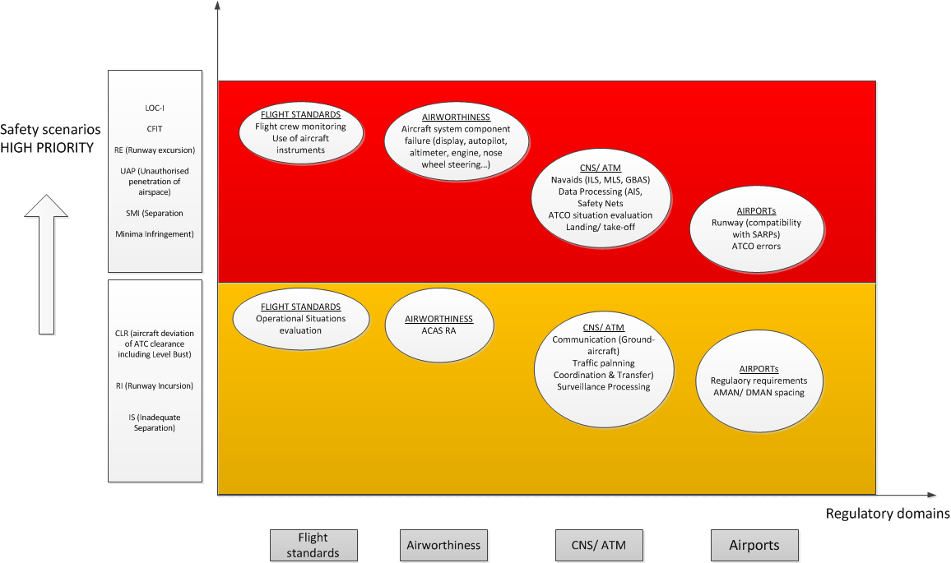
WP1.1 (STEP 3) Identification of shortcoming and bottlenecks (according to the selected severity of scenarii)

Slide 19
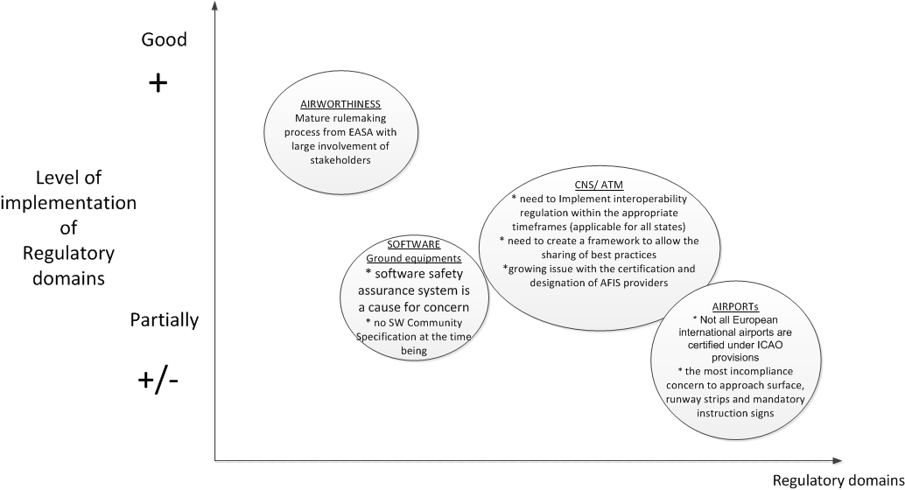
WP1.1 (STEP 3) Identification of shortcoming and bottlenecks (according to regulation level of implementation)

Slide 20
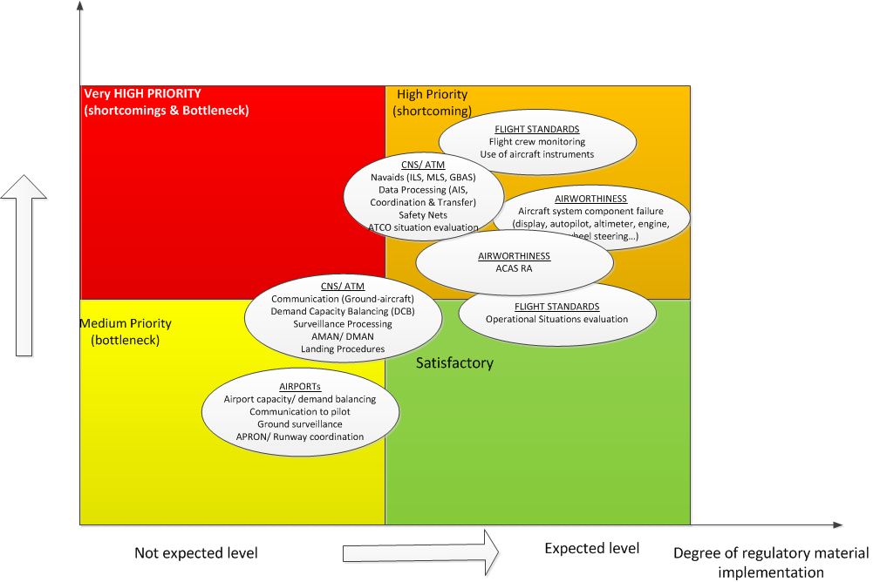
WP1.1 (STEP3) Shortcomings & bottlenecks initial identification

Slide 21
ASCOS Technical Task Meetings
WP1.1 Conclusion – main precursors per domain
Main types of precursors | FLIGHT STANDARDS | AIRWORTHINESS | CNS/ ATM | ADR
High scenarii | * Flight crew monitoring & training * Use of aircraft instruments * Pilot induced error | * Aircraft System component failure or malfunction (display, autopilot, altimeter, engine, nose wheel steering) * FMS/ RNAV/ Flight control management (e.g. instrument display, speed, altimeter…) * AIS data failure | * Navaids equipments (ILS, MLS, GBAS signal or failure) * Data Processing (AIS, Coordination & transfer) * Safety Nets * ATCO situation evaluation * ATC induced conflict (communication, timing of instruction…) * Landing procedures * Take-off incursion | * Runway markings * Obstacle assessments * Runway & airsite conditions (compatibility wit SARPs) * ATCO error
Medium scenarii | Operational situation evaluation (landing, take off, level bust…) | ACAS-RA Aircraft system failure | * Communication with pilot *Traffic planning *Coordination *Surveillance picture | Regulatory requirements AMAN/ DMAN spacing

Slide 22
ASCOS Technical Task Meetings
WP1.1 Conclusion – example findings
  Reuse of the D1.1 process
    Process is based on the understanding of the observed impact of regulation on the observed precursors to accidents/ incidents. This understanding, or observed relationship, is in effect the engine of the process. It can be reused to the proposed future total aviation system by replacing the ‘engine’ with one based on the ‘predicted impact of regulation on the predicted precursors’
  Human factors
    Due to the importance of human factors aspects as source of risks, this aspect must be considered whatever the regulatory domain (airborne and ground).
  Flight Standards & Airworthiness
    High priority shortcomings are the Flight Standards and the Airworthiness domains. As critical areas, flight crew training and monitoring, as well as aircraft systems reliability are pointed.
  ADR
    Lack of regulatory requirements to provide flight crews with a consistent format of take-off and landing data for all runway conditions
  CNS/ATM
    Stakeholders should improve their maturity regarding Safety Case approach (reusability, modularity….)

Slide 23
WP1.2 Identify and select option(s) of an adaptation of regulatory/ certification process
  1 Integrate all domains within the Authority / total concentration of expertise in the Authority
  2 Change to “Performance based” i.l.o. “Compliance based”, or the other way around
  3 Abolish all certification by Authorities and transform into a voluntary compliance with a certain safety level
  4 Make more use of competent ( certified ) entities to supplement the workforce of the authorities
  5 Certify the applicants instead of their products
  6 Use of Proof of Concept approach
  7 Do not change anything but enforce existing rules / improve existing processes
  8 Cross-domain fertilisation
To address the shortcomings & bottlenecks per domain from process & stakeholders aspects

Slide 24
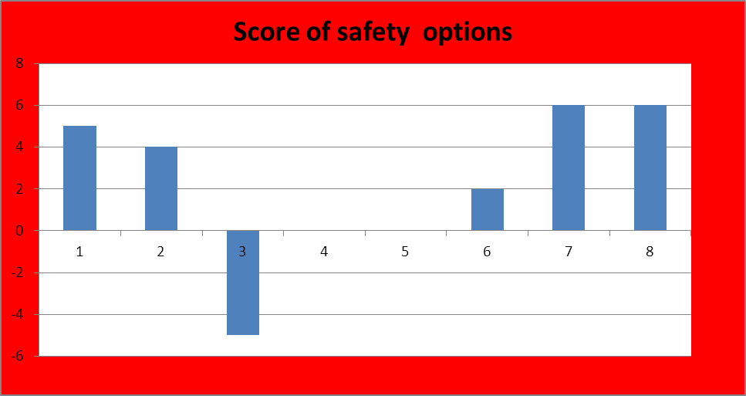
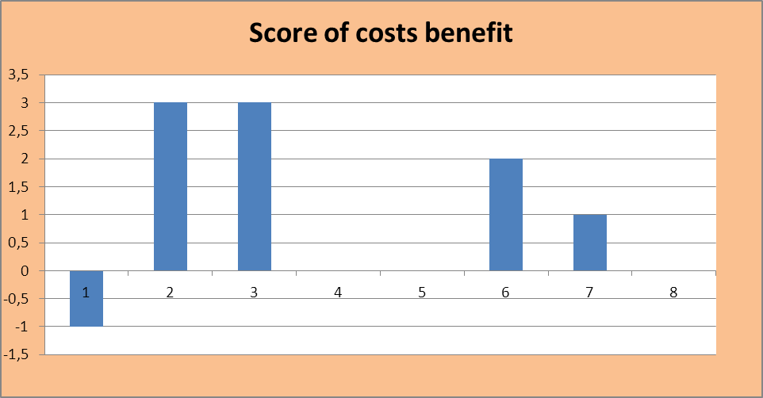
WP1.2 Score of options according to safety/ costs and a set of secondary criteria
Secondary criteria:
Throughput time
Stimulation of innovation
Required expertise
Reducing Bureaucracy (applicant & authorities)
Interoperability between domains
Harmonisation of standardisation

Slide 25
WP1.2 Score of options according to safety/ costs and a set of secondary criteria
According to safety & costs criteria the following options are further investigated by refining scoring with secondary criteria for the different domains (Authorities, Ops, ATM, Industry….)
Option 2 Change to “Performance based” i.l.o. “Compliance based”,
  Option 6 Use of Proof of Concept approach
  Option 7 Do not change anything but enforce existing rules / improve existing processes
  Option 8 Cross domain fertilization

Slide 26
Conclusion: recommendations of WP1.1 & WP1.2 for WP1.3 (development of the selected approach)
minimise unnecessary change, recognising the good approaches already in place
provide a generic certification framework encompassing the total aviation system (TAS)
use a common language across all domains based on safety argument concepts (e.g. argument-based as described by OPENCOSS), but allowing flexibility to accommodate a variety of approaches across domains
provide rigorous management of interfaces, both between domains and between the TAS and its environment – key aim is to ensure that safety issues (e.g. assumptions, restrictions) are properly addressed and not lost at interfaces
allow, within each domain, certification approach to evolve from the current approach
  keeping the existing approach where no change is required
  learning lessons from other domains where this gives improvement
  ensure that bottlenecks and shortcomings (as identified by WP1.1 and WP1.2) are addressed by the proposed approach

Slide 27
Conclusion: recommendations of WP1.1 & WP1.2 for WP1.3 (development of the selected approach)
promote flexibility within each domain to allow introduction of new technologies or procedures
harmonise approaches between domains where this is advantageous or necessary
simplify certification process where there are:
  demonstrable benefits and
  no loss of confidence in the assurance of safety
champion / reinforce existing techniques where they are appropriate but not consistently applied
provide a mechanism for identification and resolution of further bottlenecks and shortcomings

Slide 28

Contact us http://www.ascos-project.eu
WP1 Leader:
  Bernard Pauly
  TR6
  Email: bernard.pauly@thalesgroup.com
  Phone : +33179613971
ASCOS coordinator:
  Dr. Ir. Lennaert Speijker
  NLR Air Transport Safety Institute
  Email: speijker@nlr-atsi.nl
  Phone : +31 88 511 3654

Slide 29












Aviation Safety and Certification of new Operations and Systems

