Slide 1
Results so far – Work Package 2
Nuno Aghdassi
WP2 Leader / Avanssa
ASCOS UG2 Meeting
19 September 2013, Arona, Italy

Slide 2
This Presentation
Introduction and overview of WP2
WP2 Sub-task 2.1 – Framework Safety Performance
Indicators
WP2 Sub-task 2.2 – Baseline Risk Picture for Total Aviation
System
Next Steps
Contact details

Slide 3
Introduction and Overview of WP2
AVIATION SAFETY AND CERTIFICATION OF NEW OPERATIONS AND SYSTEMS
3
Objective is to create tools for Continuous Safety Monitoring, using a baseline risk picture for the safety performance of the total aviation system.
WP2.1 Framework Safety Performance Indicators (Lead: NLR)
WP2.2 Baseline Risk Picture for Total Aviation System (Lead: Avanssa)
WP2.3 Process for Safety Performance Monitoring (Lead: IoA)
WP2.4 Tools for Continuous Safety Monitoring (Lead: JRC)

Slide 4
WP2.1 Framework Safety Performance Indicators
AVIATION SAFETY AND CERTIFICATION OF NEW OPERATIONS AND SYSTEMS
Main objective:
“Define a framework of Safety Performance Indicators for the total aviation system.”

Slide 5
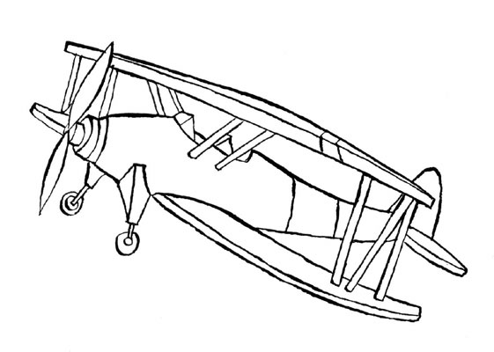
What is a Safety Performance Indicator?
AVIATION SAFETY AND CERTIFICATION OF NEW OPERATIONS AND SYSTEMS
Safety is freedom from unacceptable risk.
Risk is a combination of the frequency and severity of harm.
A indicator of the likelihood of an aircraft accident.

Slide 6
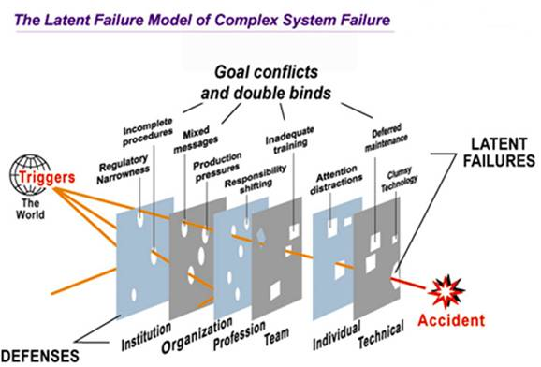
Reason’s model
AVIATION SAFETY AND CERTIFICATION OF NEW OPERATIONS AND SYSTEMS

Slide 7
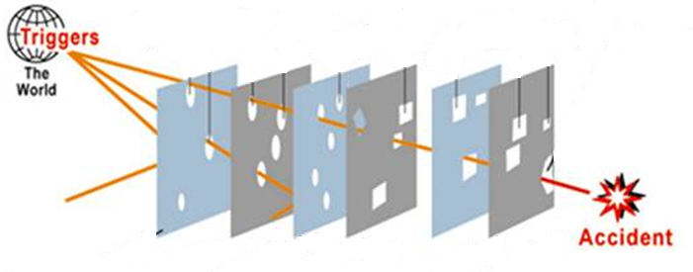
Assessing the barriers
AVIATION SAFETY AND CERTIFICATION OF NEW OPERATIONS AND SYSTEMS
System
of
Organisations
(NLR)
Organisation
(Avanssa)
Human
(Deep Blue)
Component
(NLR)

Slide 8
Operational issues identified for commercial air transport in the Safety Plan Framework of EASp
AVIATION SAFETY AND CERTIFICATION OF NEW OPERATIONS AND SYSTEMS
Safety Performance Indicators (SPI) will be developed for:
Runway Excursions
Mid-Air Collisions
Controlled Flight Into Terrain (CFIT)
Loss of Control In Flight (LOC-I)
Ground Collisions

Slide 9
General requirements for SPIs
AVIATION SAFETY AND CERTIFICATION OF NEW OPERATIONS AND SYSTEMS
Quantifiable
Representative to what is to be measured.
Provide minimum variability when measuring the same conditions.
Sensitive to change in environmental or behavioural conditions.
Cost or effort of obtaining information is acceptable
Comprehendible.

Slide 10
SPIs for the Component barrier include:
AVIATION SAFETY AND CERTIFICATION OF NEW OPERATIONS AND SYSTEMS
10
Rate of autoflight system failures/flight
Rate of electrical power system failures/flight
Rate of flight control system failures/flight
Rate of fuel system failures/flight
Rate of hydraulic power system failure/flight
Rate of ice/rain protection system failures/flight
Rate of landing gear system failures/flight
Rate of navigation system failures/flight
Rate of powerplant system failures/flight
Rate of aerodrome de-icing facilities failure/flight
Rate of autoflight system failures/flight
Rate of electrical power system failures/flight
Rate of flight control system failures/flight
Rate of fuel system failures/flight
Rate of hydraulic power system failure/flight

Slide 11
SPIs for the Human barrier include:
AVIATION SAFETY AND CERTIFICATION OF NEW OPERATIONS AND SYSTEMS
Rate of runway incursions/flight
Rate of taxiway incursions/flight
Rate of stall warnings/flight
Rate of bank angle alerts/flight
Rate of near CFIT/flight
Rate of deviation from glideslope/approach
Rate of deviation from localizer/approach
Rate of level bust at low altitude/flight
Rate of separation minima infringements (ROC>7)/flight
Rate of airspace infringements/flight
Rate of level busts/flight
Rate of high speed rejected take-off/attempted take-off
Rate of continued approach (go around not conducted) following unstabilised approach/approach
Rate of long landings/landing
Rate of excessive approach speed event/approach

Slide 12
SPIs for the Organisation barrier include:
AVIATION SAFETY AND CERTIFICATION OF NEW OPERATIONS AND SYSTEMS
12
Rate of unstable approaches/landing
Rate of deep landings/landing
Rate of flight crew failure to deploy ground spoilers/landing
Rate of delayed brake application/landing
Rate of delayed application of thrust reversers/landing
Rate of level-busts/flight
Rate of navigation errors which result in a loss of separation with another aircraft/flight
Rate of incorrect flight crew response to genuine TCAS RA warnings/warning
Rate of loss of separation events/flight
Rate of STCA warnings/flight
Rate of EGPWS events/flight
Rate of incorrect flight crew response to genuine EGPWS warnings/warning
Rate of navigational errors which result in a loss of separation with terrain/flight
Rate of MSAW warnings/flight
Rate of misuse of automation events/flight

Slide 13
SPIs for the System of Organisations barrier include:
AVIATION SAFETY AND CERTIFICATION OF NEW OPERATIONS AND SYSTEMS
13
System combined runway incursion rate
System combined taxiway incursion rate
System combined airprox rate
Operator combined erroneous weather prediction rate
System combined bird strike rate
Total number of formal safety related meetings involving at least to different type of organisations (e.g. an aerodrome and ANSP) per year
Total number of formal meetings of network of analysts to discuss safety performance measurement
The safety impact of each significant airport infrastructural change is assessed and deemed acceptable before the actual introduction of the change
The actual safety impact of each significant airport infrastructural change is evaluated at most after 3 years of implementation of the change
The safety impact of each significant aircraft modification is assessed and deemed acceptable before the actual introduction of the modification
The actual safety impact of each significant aircraft modification is evaluated at most after 3 years of implementation of the modification
The safety impact of each significant ATM provision modification is assessed and deemed acceptable before the actual introduction of the modification

Slide 14
WP2.2 Baseline Risk Picture for Total Aviation System
AVIATION SAFETY AND CERTIFICATION OF NEW OPERATIONS AND SYSTEMS
Main objective:
“Create a baseline risk picture for the Total Aviation System”

Slide 15
The baseline risk picture was created by:
AVIATION SAFETY AND CERTIFICATION OF NEW OPERATIONS AND SYSTEMS
Carrying out a comprehensive review and highlighting relevant statistical snapshots from annual safety reports produced by EASA, Eurocontrol, etc.
Quantification of key operational issues identified in the EASp using the NLR Air Safety Database (which uses ECCAIRS to manage safety data) and an improved Causal model for Air Transport Safety (CATS).

Slide 16
Causal model for Air Transport Safety (CATS)
AVIATION SAFETY AND CERTIFICATION OF NEW OPERATIONS AND SYSTEMS
CATS model provides insight into cause-effect relationships in the event sequences leading up to potential incidents and accidents.
Cover all potential failure modes of the operations during the different gate-to-gate flight phases.
CATS enables quantitative risk assessments of existing and new operations to be carried out.
Provides insight into the effectiveness and efficiency of risk mitigating measures.

Slide 17
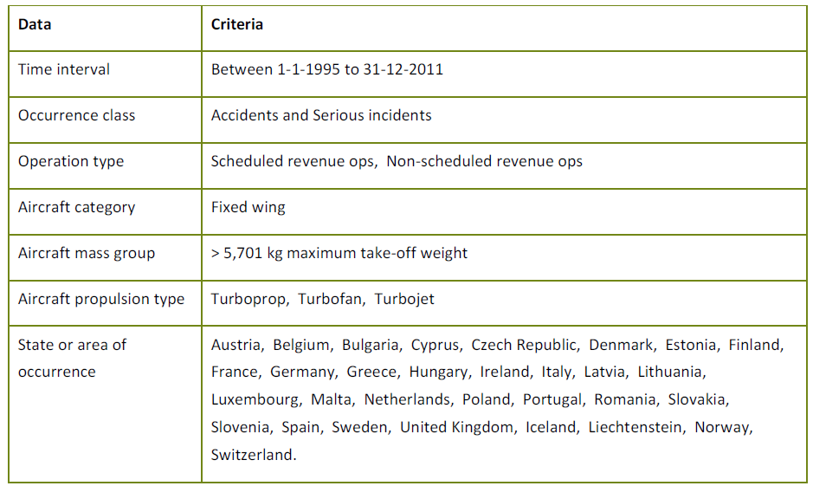
Basic ASCOS data query:
AVIATION SAFETY AND CERTIFICATION OF NEW OPERATIONS AND SYSTEMS
17

Slide 18
Frequency of EASp key operational safety issues:
AVIATION SAFETY AND CERTIFICATION OF NEW OPERATIONS AND SYSTEMS
Key operational safety issue | Frequency
Runway excursion | 1.24∙10⁻⁶
Mid-air collision | 3.67∙10⁻⁸
CFIT | 3.72 10 ⁻⁸
Loss of control in flight | 4.13∙10⁻⁷
Ground collision | 1.17∙10⁻⁶

Slide 19
Comparison with Eurocontrol Integrated Risk Picture IRP:
AVIATION SAFETY AND CERTIFICATION OF NEW OPERATIONS AND SYSTEMS
19

Slide 20
Conclusions
AVIATION SAFETY AND CERTIFICATION OF NEW OPERATIONS AND SYSTEMS
Significant overall improvement in aviation safety in the last 2 decades.
Europe has consistently experienced a low rate of fatal accidents compared with many other regions of the world.
Pick-up in air traffic following the economic downturn may also result in an increase of occurrences.
About 40 % of all fatalities occur in accidents which happen during the approach and landing phases of flight.

Slide 21
Conclusions (cont.)
AVIATION SAFETY AND CERTIFICATION OF NEW OPERATIONS AND SYSTEMS
Despite being infrequent LOC-I accidents result in higher numbers of fatalities when compared, for instance, to runway excursions.
Of the 5 event categories, runway excursions and ground collisions are more frequent.
CFIT, mid-air collisions and loss of control in-flight events are associated with higher rate of fatalities.

Slide 22
Next steps
AVIATION SAFETY AND CERTIFICATION OF NEW OPERATIONS AND SYSTEMS
Sub-task 2.1, D2.1 – Completed
Sub-task 2.2, D2.2 – Completed
WP2 sub-task 2.3 – Process for safety performance monitoring – In-progress
WP2 sub-task 2.4 – Tools for continuous safety monitoring – Pre-planning

Slide 23
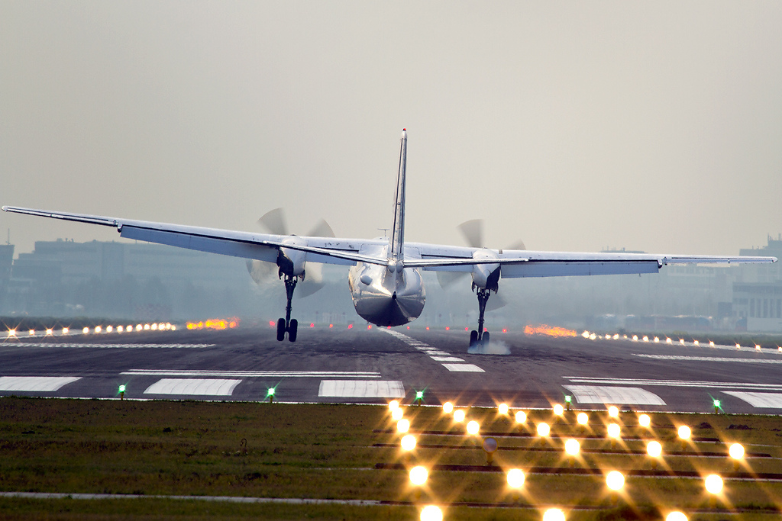
Contact us http://www.ascos-project.eu
WP2 Leader:
Nuno Aghdassi
Avanssa
Email: nuno@avanssa.com
Phone : +351 917 209 267
ASCOS coordinator:
Dr. Ir. Lennaert Speijker
NLR Air Transport Safety Institute
Email: speijker@nlr-atsi.nl
Phone : +31 88 511 3654

Slide 24
Aviation Safety and Certification of new Operations and Systems

