Slide 1
CATS
A tool for risk analyses in safety Management
19/20 September 2013
Jos Wilbrink,
Rob van der Boom

Slide 2
Content
Objective
Background
Needs and scope
Model set up
An example of safety analyses
Concluding remarks

Slide 3
Objective
The prevention of aircraft accidents through better understanding of aviation risks in terms of causes and magnitude

Slide 4
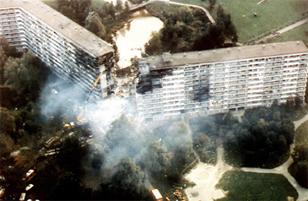

Slide 5
How to improve a very safe system?
Safety Management in industry and government: to apply what we know, improve the remaining weaknesses and evaluate system changes
Risk Management is an essential part of Safety Management: risk identification, risk quantification and risk reduction

Slide 6
What we need in CATS
A flexible tool for risk management
A high level holistic approach of risks in Aviation - strategy
Tool for risk identification and risk quantification
Tool to analyze causes, risk contributors and sensitivity bands in detail
A logic tool that covers today’s risks
A logic tool to evaluate future risks
Base to set priorities

Slide 7
Some options
Setting Safety-priorities
  Engine failure ETOPS improvements?
  Unstable approach Improved weather info?
  Runway incursions Improved communication?
  Ground collisions Moving map in cockpit?
Impact of options for safety improvements
  Magnitude of safety improvements to be expected from new or amended procedures and equipment

Slide 8
Scope of CATS
A Risk analyses tool to support decision making in safety management
Describes the total aviation system safety
Through 33 accident scenario’s (ESD’s)
Underlying causes (Fault trees)
Human Performance Models (Crew, ATC, Maintenance)
Management Model
Generic consequence model (Accident, fatalities, costs)

Slide 9
Fatal accidents: historical data

Slide 10
Fatal accident scenario’s in CATS

Slide 11
Initial CATS set up
Consequences: risk of accident, fatalities, costs
ESD: Description of a voyage from gate to gate, encounter of all risks in air transport, represented in 33 risk scenario’s
Each scenario detailed in fault trees
Addressing the 3 operators: Cockpit crew, Controller and maintenance engineer
Ruled by management
ESD
Fault tree
Basian Belief Net

Slide 12
Event Sequence Diagram (example)

Slide 13
Fault tree (example)

Slide 14
Analyses tools in CATS
CATS contains ESDs and associated Fault Trees for analyses of causes and contributions to all accidents
CATS can be used to reflect the exceptional next to average situation
CATS can be used to correlate accident scenarios and perform sensitivity analyses (e.g. how much influence do certain factors/events have on different scenarios)

Slide 15
Test case: initial application
Safety case TK 1951
To investigate that part of the system associated with the TK 1951 accident on 25 February 2009, the CATS structure describing unstable approach is one of several possibilities and this is the one used in the following

Slide 16
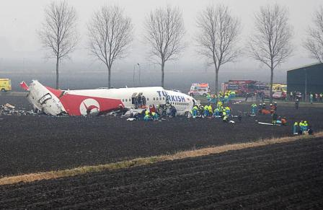
TK 1951 accident, 25 February 2009

Slide 17
Case TK 1951
Study of the safety risks related to a flight with:
One Radio Altimeter US
Crew training
Limited alertness of the crew
General Setting of the model:
European operator, maintenance
Western modern Jet, third generation
Max take off mass: 136-300 tonnes
Standard GPWS

Slide 18
ESD 19 Unstable approach

Slide 19
Default Unstable Approach fault tree

Slide 20
TK 1951 Unstable Approach fault tree

Slide 21
Effect of barrier failures

Slide 22
Case TK 1951
Model settings to represent the case:
Poor automated systems management causes Unstabelised Approach – Set on 100% risk

Slide 23
Test case: observations
It is possible to use CATS to investigate individual accidents that have occurred & obtain more insight
In official incident/accident investigation by Dutch Safety Board, it is concluded that TK1951 accident should be classified as unstable approach (ESD 19)
  Unstable approach;
  Flight crew fails to initiate and execute a missed approach
  Flight crew fails to maintain control – collision with ground.
Note: complete study should address all potentially applicable scenarios (and not be restricted to one)

Slide 24
Data and information for CATS
Accident and incident information
  NLR Air Safety Database
  ICAO ADREP
  Airclaims
  Service Difficulty reports
  Line Operations Safety Audits (LOSA)
Expert judgment

Slide 25

Timeline of CATS
Validation & policy support
Initial Research
Basic Research
Applied Research and Development
1993
Wish: causal risk model
2002 - 2003
Demo
2005
Start CATS
2009
Start Test Phase
2009 -2012
RPAS
2011- 2012
Next Gen
2012
Start ASCOS
2015
End ASCOS

Slide 26
Ongoing (partly in ASCOS)
Cooperation between users
Continue user test phase
  Validation / perform relevant safety cases
  Adapt CATS to suit various users (authorities and sector)
  Secure reliable data sources
  Improve the data input process
  Research on specific areas (e.g. emerging/future risks)
Implementation as tool for safety policy

Slide 27
Concluding remarks
The objective of CATS is to further improve safety. The aviation community needs advanced safety-risk analyses tools, that deal with the total aviation system, for adequate risk management
CATS describes and models the total aviation system safety
CATS is a flexible tool that can represent many safety cases to support informed decision making in safety management
CATS in validation and application phase (is used in practice)
CATS research on specific areas to extend scope of applicability
CATS may be used by variety of users (e.g. authorities, industry)

