Slide 1
ECCAIRS & ASCOS
User Group meeting #2
19-20 September 2013 Arona
W. Post & R. Menzel
Joint Research Centre European Commission

Slide 2
Contents
ECCAIRS background
ECCAIRS in ASCOS

Slide 3
Role of the JRC
JRC is the European Commission’s in-house science service providing the science for policy decisions … to ensure a productive economy as well as a safe, secure and sustainable future
Our Mission… is to provide customer-driven scientific and technical support for the conception, development, implementation and monitoring of EU policies
Our Vision… is to be a trusted provider of science-based policy options to EU policy-makers to address key challenges facing our society, underpinned by internationally-recognised research

Slide 4
ECCAIRS Mission and Scope
“Assist National and European transport entities in collecting, sharing and analysing their safety information in order to improve transport safety”
Network
European Commission and Transport agencies and EU Competent Authorities
International Organisations (EUROCONTROL, ICAO, IMO)
Services
Reporting and data integration environments
Taxonomy management and maintenance
Training and support
Tools
The ECCAIRS Reporting System

Slide 5
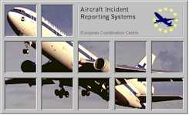
ECCAIRS History
1991 IFALPA Share data … improve safety
1991-1995 Feasibility study
1998 ECCAIRS 3.1
2002 ECCAIRS 4.1
2003 Directive 2003/42
2007 Regulations 1321/2007 and 1330/2007
2010 Regulation 996/2010 ECCAIRS Maritime (EMCIP)
2011 ECCAIRS 5.1
2012 ECCAIRS Railways (ERAIL)

Slide 6
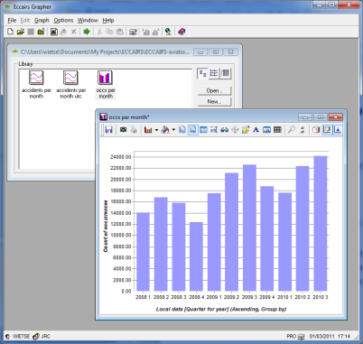
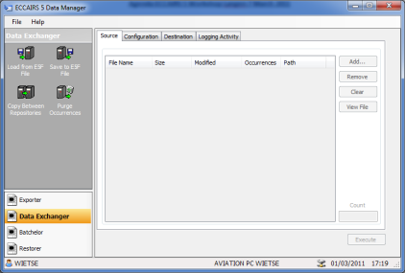
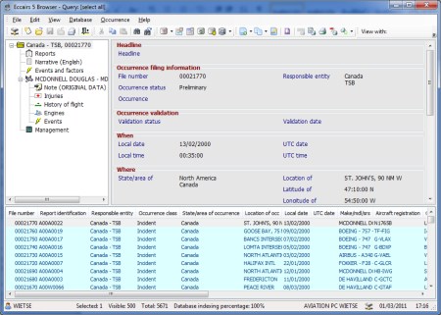
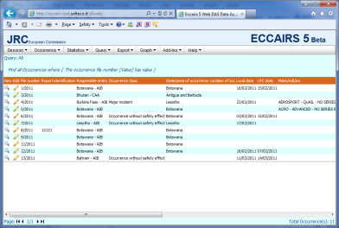
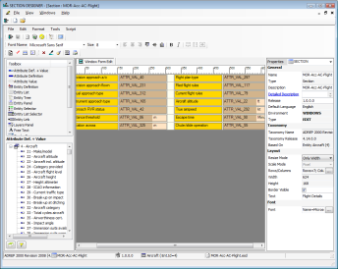
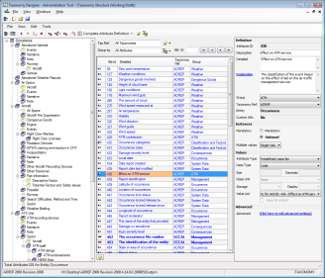
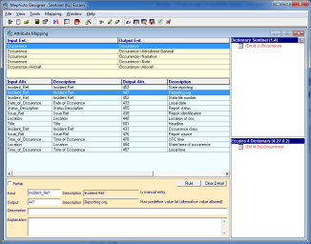
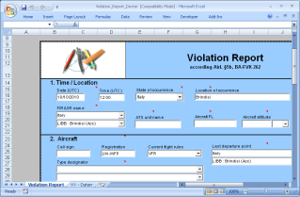
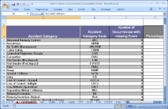
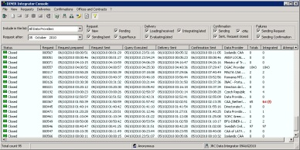
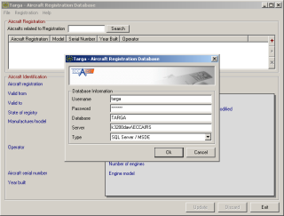
ECCAIRS 5 Reporting System suite
Data Manager
Grapher
Browser
WebDAS
UIDes
TaxDes
Mephisto
Dexter
RefX
AWB
DINER

Slide 7
European Central Repository
Core of a data integration network
Contributions by all Member States (legal mandate)
More than 700.000 occurrences
Accessible to all competent authorities (CAA and SIA), EASA and Eurocontrol with restrictions (narratives, operator, etc)
Interested parties can ask for information via national contact point
Main issues
Reporting discipline and culture … data quality
Accessibility

Slide 8
JRC in ASCOS
Competence in the building of tools related to safety databases and their usage
No particular aviation expertise in general nor in the area of Certification
Bidirectional
ECCAIRS expertise to be used in ASCOS
ASCOS (technical) output to be propagated to aviation community
Contacts in the aviation community
Safety reporting
Data storage and retrieval
Data availability

Slide 9
WP 2.4 Task definition
To demonstrate the applicability of the results coming out of WP2.1, WP2.2 and WP2.3 a set of tools will be developed
The tools will use safety data extracted from an ECCAIRS compatible repository (ECR, ADREP or national occurrence databases) complemented with (historical) exposure data

Slide 10
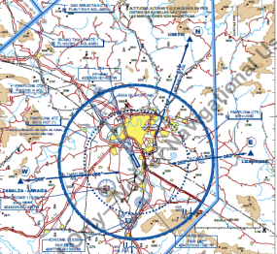
Approach
Develop tools based on ECCAIRS
Use existing tools to the extent possible
And develop new capabilities where required
Use a flexible approach that can be extended to other issues
E.g. inclusion of other aspects of the total aviation system
Aim to make tools useable for other monitoring no covered by ASCOS
ICAO Continues Safety Monitoring
EU safety monitoring
Availability / quality of data is a concern (EASA, ECTL, ADREP, ECR,…)
But not part of this work package

Slide 11
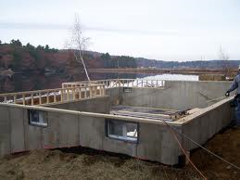
Framework for indicators
Technology
Human
Organisation
System of Organisations

Slide 12
Caution
Some proposed indicators are not occurrence data based
E.g. number of conferences etc.
Integration of “expert opinion” into data driven indicators not clear
JRC does not express opinions on indicators/tools selected, nevertheless
Indicators and their layout should be understandable an the industry audience
Numerous individual indicators have been proposed, but integration / overall picture unclear
Notes:
Some of the selections are not intuitively understandable:
e.g. why are “long landings” found under “Human” and “deep landings” under organisation
Why “level bust at low level” under “human” and “vele bust” under “organsation”.
Why are ground spoiler failure to deploy under “organisation” and not under “human” (if it was related to crew action) or technical- if a technical falure was involved.

Slide 13
Data availability
Occurrence data
ECR – access to ECR data needs to be established
Application of present regulations
Data quality issues
ICAO Accident/serious incident data
Access to ADREP data would need to be established
Exposure data
Access to the EASA data warehouse (what specifically does it contain?)
Access to ECTL exposure data (to the extent data not at hand in the EASA data warehouse)
Other sources ? (data related to the usage of specific aircraft models)
Expert opinions
Format/structure? Source? Availability? Compatibility with occurrence data?

Slide 14
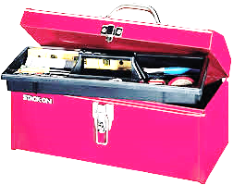
The tools
Queries
Ability to query contents of ECCAIRS type data bases at hand
Comes with the system
Performance ok
Grapher
Quick design of graphs based on queries
Limited to data in the ECCAIRS data base
Aggregate Work Bench (AWB)
Integration of query results into spread sheets (Excel)
Permits use of data from various sources
E.g. ECCAIR data and exposure data
Ability to deliver Charts, Indicators, Graphs
Exporter
Exports ECCAIRS data into various formats as required
Link to other analysis tools

Slide 15
Sample graphs: Distribution of technical subjects : occurrences and accidents

Slide 16
Sample graph: Technical subjects for two manufacturers

Slide 17
Sample Graph: Relative frequency of a technical subject by manufacturer
Notes:
A,b,c,d,e – are showing the relative frequency of such reports for the given manufacturer. Note that we have at present no exposure data that would permit the determination of manufacturer (and for this matter model/series) related rates.

Slide 18
Monitoring of a system

Slide 19
Monitoring of a system

Slide 20
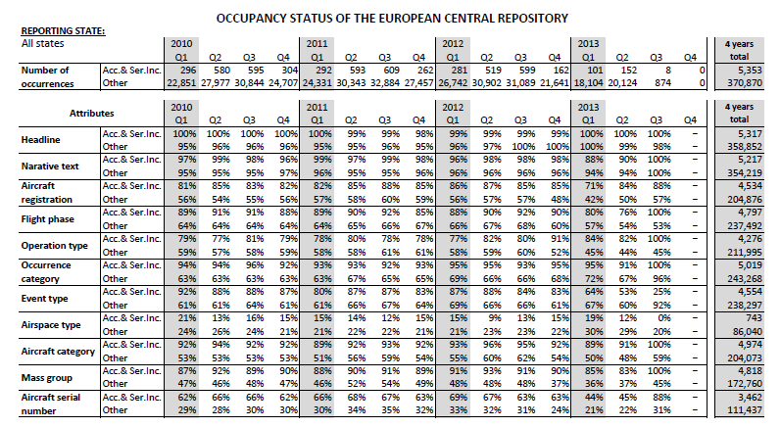
ECR - data quality issues – example of coverage analysis

Slide 21
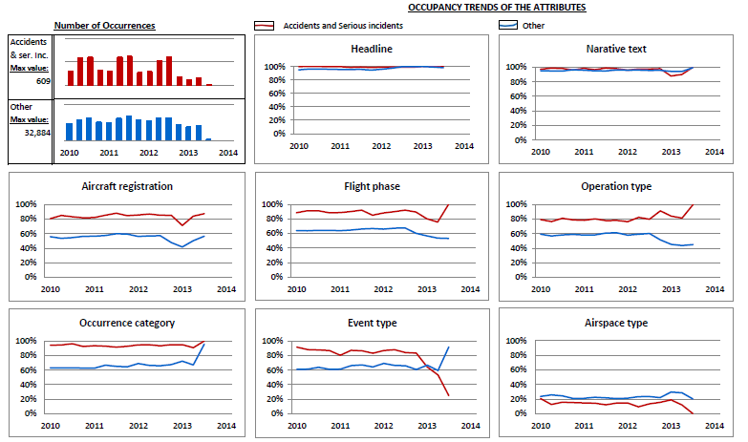
ECR - data quality issues – graphical representation

Slide 22
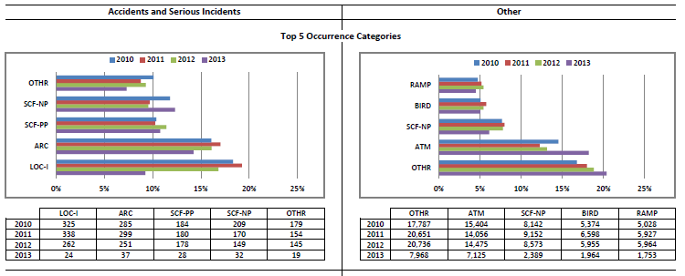
ECR – distribution of top occurrence categories

Slide 23
Questions ?

Slide 24
Aviation Safety and Certification of new Operations and Systems

