Slide 1
Future Work – Work Package 1
Bernard Pauly
WP1 Leader / TR6
ASCOS UG2 Meeting
20th September 2013, Arona, Italy

Slide 2
Content
WP1.3 (Task leader EBENI): Outline certification approach
WP1.4 (Task Leader TU-Delft): ASCOS E-Learning environment

Slide 3
Objectives of WP 1.3
Develop an outline certification approach that could be used to cover the certification of changes in the Total Aviation System
The new approach must offer improvements over the existing certification/approval processes in terms of
efficiency in cost and time
ability to analyse and demonstrate acceptable safety for new concepts and technologies
ability to analyse and consider the Total Aviation System rather than sub-elements in isolation
Whilst not undermining the efficacy of existing process!

Slide 4
Regulatory Framework
Consider regulation framework as a three tiered structure of requirements and guidance within the domains
Albeit the boundary between these tiers can be blurred
Regulation and legislation
Approach to compliance / acceptable means of compliance
Industry standards, recommended working practices, guidance
The primary focus of the new approach is to consider how to improve 2. the approach to compliance
But may make recommendations for changes to regulation or standards
Where this gives a significant benefit through harmonisation or simplification

Slide 5
Certification/Approval Framework
Certification/Approval is a means to determining acceptability
Common to all domains
Risk from equipment, systems, services, operations, organisations must be acceptable to travelling public and 3rd parties
Acceptance criteria established by Convention, Regulation, Legislation, Standards, NSAs, etc.
Many types of logical argument for acceptance but not always explicitly expressed as an argument
E.g. performance-based, compliance-based, assurance-based, organisation-approval/ licencing, etc.
Framework needed to
Ensure consistency inter and intra domain
Manage the interfaces between arguments

Slide 6
Common Certification/ Approval Language
Approaches to certification should be based on sound scientific reasoning
The safety argument approach is a good basis for a common language
Based on the research and perhaps taking insight from OPENCOSS
Restating domain certification approaches in a common argument form we think will help
Promote flexibility
Harmonise approaches between domains
Simplify certification processes
Champion / reinforce existing regulation, approaches and techniques
Better understand and capture the assurance interface between the domains
Better understand and capture the assurance interface between lifecycle stages
E.g. from design certification through to ongoing oversight
BUT with any method there is always the possibility for abuse
Therefore there needs to be clear guidance on applying the method

Slide 7
Outline Process for WP1.3
Partition total aviation system (TAS) into non-overlapping domains
Distribute questionnaire within partner and user group organisations
Determine approach to current certification / approval practices within domains
Identify key claims, assumptions, dependencies, limitations, etc. at the interface with other domains
Identify further specific bottlenecks and shortcomings
Identify current good practice within domain and in other industries
Review each domain (and the TAS as a whole) to consider how certification practice could be improved or changed
Focus on most promising options from WP1.2 using representative certification safety arguments
Candidate options to be evaluated further as part of the case studies in WP4
Define the outline certification approach for initial review and application within the case studies
Including guidelines on developing certification safety arguments

Slide 8
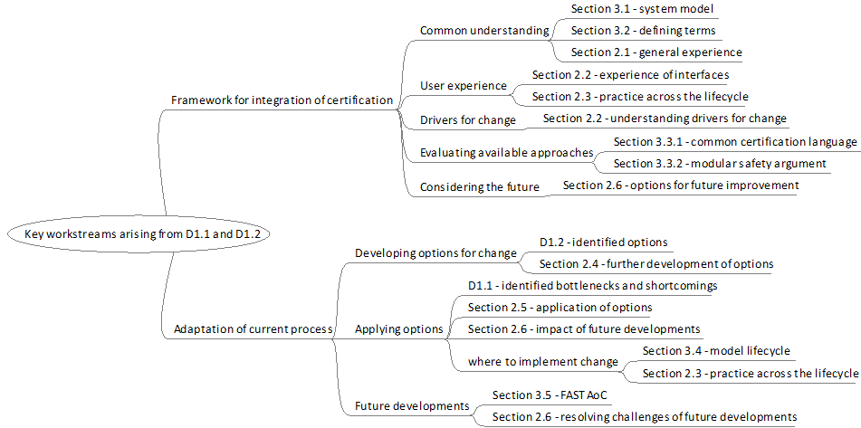
WP1.3 How to proceed ?
Based on D1.1 & D1.2 results, develop and exploit a questionnaire in order to structure issues, recommendations, options….between domains
Designed to gather “real world” perspectives on certification / approval practices

Slide 9
WP1.3 Steps to follow, with guidance for each step
Step 1: Describe the proposed change (operation, system, product, timeframe, affected domains, human aspects affected, …)
Step 2: Regulations, standards and/or guidance material (AMC, AMOC, …)
Step 3: Liaise with authorities & involved stakeholders
Step 4: Develop certification plan including argument
Step 5: Perform a priori safety risk assessment
Support in e-Learning environment

Slide 10
WP1.3 Steps to follow, with guidance for each step
Step 6: Perform activities specified in certification plan
Step 7: Initial approval by authorities
Step 8: Continuous safety monitoring (e.g. collation of information for safety monitoring, analysis of safety performance indicators, …)
Step 9: Perform a posteriori safety risk assessment
Step 10: Approval of continued safety certificate(s)
Support in e-Learning environment

Slide 11
WP1.3 Activities short term
Incorporate results WP1.3 questionnaire in further update
Discuss with User group members at the ASCOS UG2 Workshop
Provide further updated outline certification process (set of slides only), to selected User Group members for feedback
Before 1 October 2013
Draft Chapter “Outline certification process” for ASCOS D1.3
Before 1 November 2013

Slide 12
WP1.3 Deliverable
Outline Certification Process should provide sufficient detail
For stakeholders to evaluate the process
Demonstrate that the process is practical and covers the range of systems required
Show how an adequate level of safety is assured
For application within the WP4 certification case studies
D1.3 Report on Development of new certification approach
Due 1 December 2013 (new date)
Will become available in the Public Domain

Slide 13
WP1.4 E-learning environment
A set of modules is being developed, focusing on ASCOS methods/tools:
WP1 Certification Process
WP2 Continuous Safety Monitoring
WP3 Safety Risk Management
Responsibility for the e-learning environment is with TU Delft (task leader)
A first version of e-learning environment is being established (12 modules)
E-learning environment becomes available at http://blackboard.tudelft.nl
Initially, it is restricted (Username and Password will be required)
Evaluation of draft version with User Group members is foreseen
Contributions from User Group members possible (appreciated!)
Final version e-learning environment: becomes publicly available

Slide 14
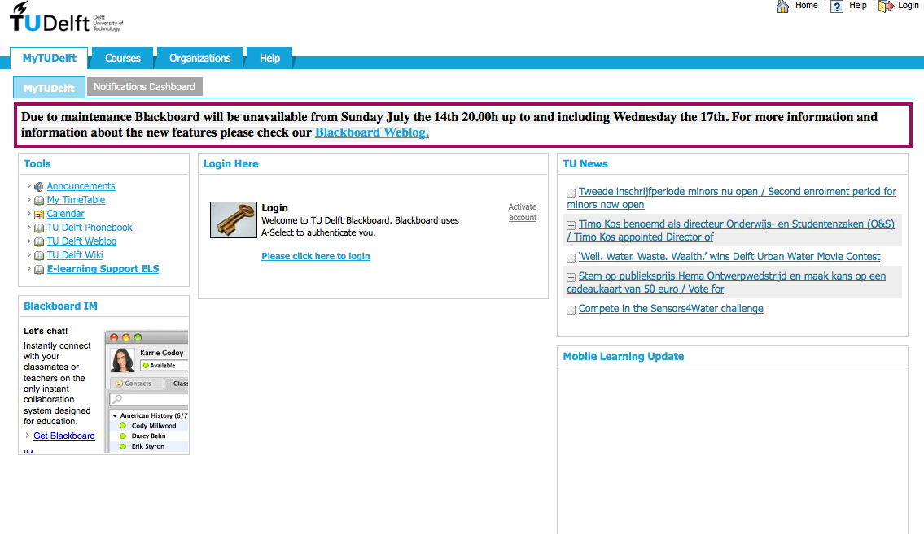
WP1.4 E-learning environment: Technical Solution
Requirements & functional analysis (completed)
Platform Implementation (completed)
http://blackboard.tudelft.nl
Platform delivery, support, maintenance (in progress)

Slide 15
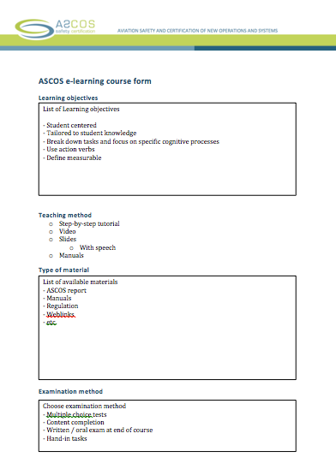
WP1.4 E-learning environment: Content Guidelines
Course Form to standardize information about each ASCOS course.
In progress
Structure:
Learning objectives
Limited number of goals for the course
Teaching Method
One or more selected methods to present knowledge
Type of material available
Material the course is based on
Examination method
Way to test that learning objectives are fulfilled
Step-by-step manual to publish course in Blackboard
In progress

Slide 16
WP1.4 E-learning environment modules

Slide 17
Contact us http://www.ascos-project.eu
WP1 Leader:
Bernard Pauly
Thales Air Systems (TR6)
Email: bernard.pauly@thalesgroup.com
Phone : +33 1 79 61 3971
ASCOS coordinator:
Dr. Ir. Lennaert Speijker
NLR Air Transport Safety Institute
Email: speijker@nlr-atsi.nl
Phone : +31 88 511 3654

Slide 18
Aviation Safety and Certification of new Operations and Systems

