Slide 1
Aviation safety & certification of new operations and systems
WP4 – Certification Case Studies
User Group Meeting 2
19 & 20 September 2013

Slide 2
Objective
Apply the new certification approach in example case studies
Evaluate the practical application
Assess the overall safety impact of proposed safety enhancements

Slide 3
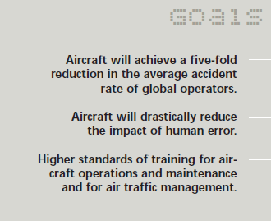
Background and scope
Notes:
Proposed operational/system changes in total aviation system
Proposed changes should enhance safety of operational issues
Commercial Air Transport (scheduled flight, passengers/cargo)
Contribution to reaching the ACARE Vision 2020 safety goals
Time frame (specifying how far ASCOS looks into the future) for actual introduction of proposed changes is around 2020
Application of proposed certification process adaptations, delivered by ASCOS WP1.3, assuming take up by authorities

Slide 4
Which case studies?
Focus on operational issues identified in the EASp
Operational safety issue | Sub-WP
Controlled Flight Into Terrain | WP4.1
Loss of control in flight | WP4.2
Ground collision | WP4.3
Mid-air collision | WP4.4
Runway excursion | Not covered

Slide 5
Case study topics
Aircraft failure management system (WP4.1)
Improved aircraft controllability system (WP4.2)
Ground (handling) operations (WP4.3)
ATM/CNS system for improved aircraft surveillance (WP4.4)
Topics are to be defined in more detail
with support of the User Group

Slide 6
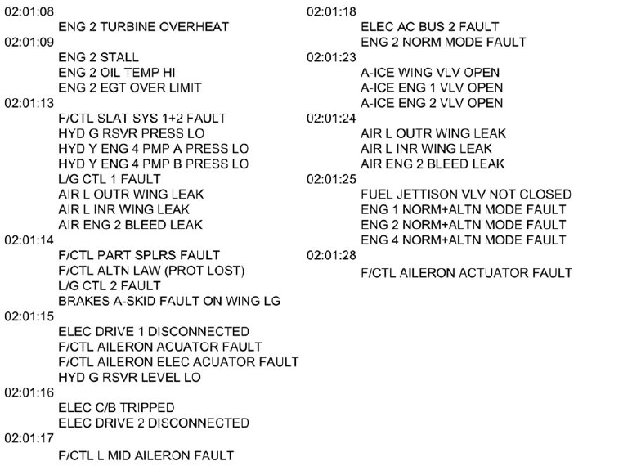
Aircraft failure management system

Slide 7
Improved aircraft controllability system

Slide 8
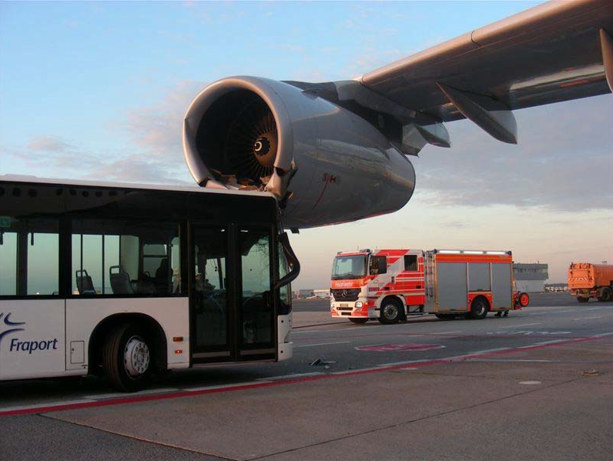
Ground (handling) operations

Slide 9
ATM/CNS system for improved aircraft surveillance

Slide 10
Common approach for each case study (WP1.3, draft)
Describe the proposed change (in ASCOS)
Applicable safety and certification documentation (in ASCOS)
Liaise with authorities and involved stakeholders (in ASCOS)
Develop a certification plan (in ASCOS)
Perform a priori safety risk assessment (in ASCOS)
Perform activities specified in certification plan (partly ASCOS)
Initial approval by authorities
Continuous safety monitoring
Perform a posteriori safety risk assessment
Approval of continued safety certificate(s)

Slide 11
Role of the user group
Initial definition of cases
Discussions October 2013 - December 2013
Decisions December 2013
Informal discussions on intermediate results
Reality check
Expert opinion
Provision of documentation and data

Slide 12
Aviation Safety and Certification of new Operations and Systems

