Slide 1

Introduction to EASA and expectations
Workshop User Group 1
30 October 2012
NLR Amsterdam
Ken Engelstad

Slide 2


European Union and EFTA countries
27 EU states
4 EFTA states

Slide 3


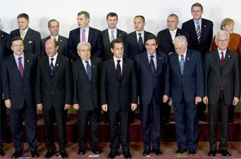

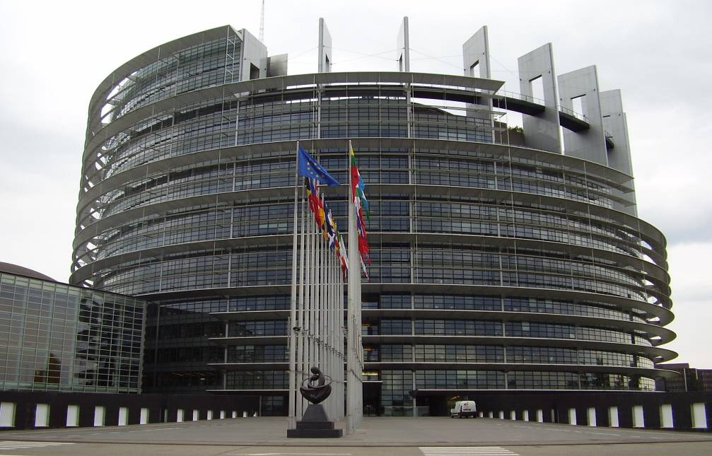


The institutions
Council of the European Union
European Council
European Court of Justice
European Parliament
European Commission
EASA

Slide 4

The EU aviation safety system
Proposes rules
Issues some certificates and approvals
Performs inspections
Manages European Aviation Safety Programme
European Aviation Safety Agency
European Commission
Adopts rules
Launches infringement procedure
Manages Safety List
National Aviation Authorities
Issue most certificates, approvals and licences
Oversee organisations
Implement EU law
Industry

Slide 5
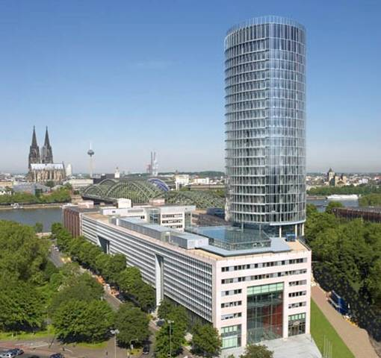





The European Aviation Safety Agency - EASA
European Union Agency
Technically independent
Legal and financial autonomy
“Ever safer and greener civil aviation”

Slide 6
About EASA
Founded in 2003
Located in Cologne, Germany
Headed by Mr Patrick Goudou
Staff of more than 700
Built on experience from the JAA

Slide 7
Scope
Economic regulation
Operations & FCL
3rd Country
Operations
Aerodromes
ATM/ANS
Airworthiness
Performance regulation
Safety regulation
total System approach
Interoperability regulation

Slide 8
Regulatory Structure
Basic
Regulation
  Agency Opinion
  European Commission
  European Council
  European Parliament
Implementing Rules
  Agency Opinion
  European Commission
Soft Law
  Agency Decision
  AMC, GM, CS
Acceptable Means of Compliance
Guidance Material
Certification Specifications

Slide 9
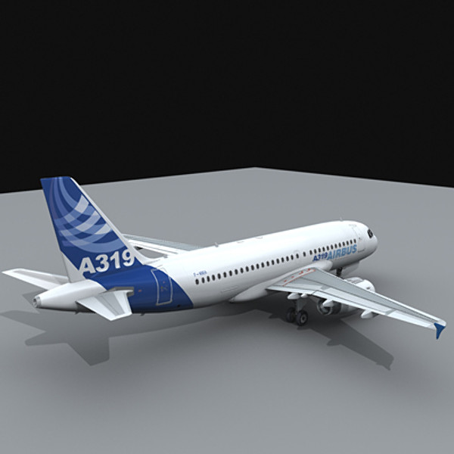




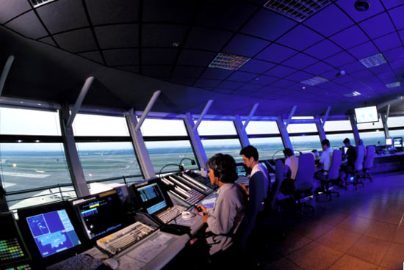

Current Regulations
Basic Regulation (EC) No 216/2008
Airworthiness
Flight Standards
ATM/ANS
Initial Airworthiness
Continuing Airworthiness
Air Crew
Air Traffic Controllers Licences
ATM/ANS Oversight
ANS Providers
AUR and ACAS II
9

Slide 10
ATM/ANS rules (EASA) in force
Basic Regulation (amended by Reg 1108/2009)
ATM/ANS
Providers
1035/2011
Competent
Authorities
1034/2011
ATCO
Licensing
805/2011
SERA
Reg
923/2012
Airspace
Usage
1332/2011
Systems
ATM
systems
Part ACAS
(ADR
equipment)
and also …
Part HETA
Certification
Specifications -
ATM on-board
equipment
ATM
performance
scheme
10

Slide 11
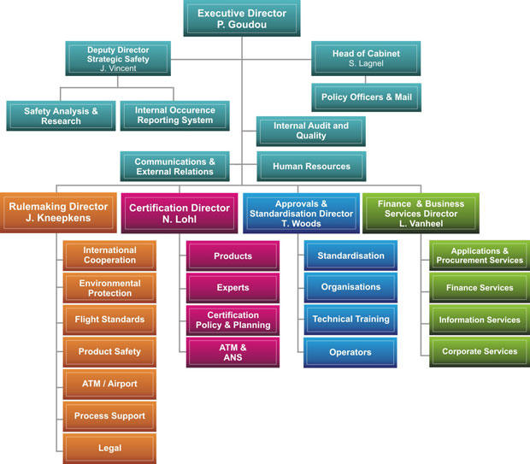
Organisational Chart

Slide 12
EASA Certification Directorate
Certification Directorate
C.1 Products
C.2 Experts
C.4 Policy and Planning
C.5 ATM /ANS
The Certification Directorate contributes to a safe and environmentally compatible aviation system in Europe by performing the following core activities:
Product airworthiness
Continuing airworthiness oversight;
Environmental certification;
Flight standards certification (operational evaluations);
Air Traffic Management and Air Navigation Systems (ATM/ANS) activities

Slide 13
The Certification process at EASA
Phase I - Technical familiarisation and establishment of the initial Type Certification Basis
The applicant shall provide the EASA certification team with detailed technical briefings about the product, its design, technologies, unique features, etc.
The PCM drafts the initial Type Certification Basis, i.e. the applicable certification specifications, including environmental protection requirements

Slide 14
The Certification process at EASA
Phase II – Agreement of the Certification Programme
Discussion of certification team and agreement with applicant on the certification programme which:
  defines the proposed means of compliance with the type certification basis,
  describes all the activities and level of team involvement with respect to compliance demonstrations, test witnessing, compliance tracking, compliance records, conformity statements, time schedule for achieving compliance, etc.

Slide 15
The Certification process at EASA
Phase III – Compliance Determinations
The applicant is responsible for showing compliance with the certification basis. He will also:
  define the EASA Type Design,
  produce a procedure to cover equipment qualification,
  produce a statement of conformity for certification tests,
  produce the required certification documents,
  conclude each compliance report with a Declaration of Compliance with the applicable requirements.

Slide 16
The Certification process at EASA
Phase IV- Final Report and issue of a Type Certificate
On completion of the certification programme the applicant shall provide a declaration of compliance with the Type Certification Basis.
The PCM shall then produce a Final Certification Report („Technical visa“) which is presented to the Certification Manager for approval.
The type certificate is issued and handed over to the applicant.

Slide 17
Certification and oversight activities for systems in ATM/ANS
Certificate only at organisation level
No certification of ATM/ANS ground systems
Safety assessment of changes to functional systems
Functional System is defined as “a combination of systems, procedures and human resources organised to perform a function within the context of ATM”
Oversight by Competent authority
EASA= CA 1034/2011
(ESSP, NM)
Review and acceptance of the introduction of new functional systems or changes to the existing one

Slide 18


Certification and oversight activities for systems in ATM/ANS
At EASA, these activities are performed by experts of the ATM/ANS Department, part of the Certification Directorate, together with external experts from accredited NSAs and Qualified Entities.

Slide 19
Two different approaches today
Aeronautical products | ATM
Basic Regulation 216/2008 requires EASA to take the responsibility for the design approval of products, parts and appliances designed, manufactured or used by persons/organisations under the regulatory oversight of EU Member States | Basic regulation 216/2008 With the adoption of the SES II legislative package, and of the Regulation (EC) No 1108/2009 extending the EASA competence in the field of aerodromes, air traffic management and air navigation services, the scope of the certification process is extended to include “aeronautical products, parts and appliances, aerodromes and their equipment, operators involved in commercial air transport and in the operation of aerodromes, ATM/ANS systems and providers”.
Regulation 748/2012 The European Commission adopted subsequently Commission Regulation (EC) No 1702/2003, now repealed by Regulation (EU) No 748/2012, which specifies inter alia the requirements applicable to products, parts and appliances and also provides for the grand-fathering of pre-existing certificates under conditions that aim at ensuring that they meet the level of safety required by the Basic Regulation and its implementing rules. | SES Regulations Common requirements to ensure that air navigation services are provided safely and efficiently, on a continuous and interoperable basis, throughout the Community. It introduces a harmonised system of certification. Implementing rules relating to the certification of the design, manufacture and maintenance of ATM/ANS systems and constituents, as well as to organisations engaged in the design, manufacture and maintenance will only be laid down when related to safety-critical issues identified following a detailed impact assessment study.
EASA certification process | ANSP Safety case

Slide 20
EASA in the User group 1 - ASCOS
EASA Expectations

Slide 21
Expectations (1/3)
The aim of the Call of FP7 (Activity 7.1.3 - Ensuring customer satisfaction and safety) to be ensured.
“…to ensure that aviation safety remains at current high standards or even improves regardless of air transport growth, through increased enhancement of safety in air transport operations. Research work will address a wide range of concepts, innovative solutions and technologies which will result in safer operation of basic infrastructures of the system, such as airports and air traffic management as well as in improved integrated safety solutions. […]”

Slide 22
Expectations (2/3)
One of ASCOS’ objectives is to “analyse the existing European certification and rulemaking process and propose potential adaptations for speeding up certification while ensuring adequate safety”
EASA expects to see how:
novel processes can be proposed to perform environmental and airworthiness certification of aeronautical products, parts and appliances and of ATM/ANS systems and constituents,
the impact on the current EU/EASA regulatory framework and certification process will be assessed

Slide 23
Expectations (3/3)
EASA specifically interested in being informed on:
  the four certification case studies selected :
  1. Aircraft failure management systems
  2. ATM / CNS systems & operations
  3. Aircraft systems for improved controllability in flight
  4. Aircraft ground handling warning systems
  Feedback on proposed adaptations of existing certification process
ASCOS team to maintain active coordination with EASA

Slide 24
Final Remarks
EASA expectations to be clearer once Commission proposal on SES II+in 2013 revealed
Proposal to create a WP identifying the advanced concepts and procedures in support of novel approaches to certification in the framework of Regulation 748/2012 and the SES Regulations encompassing airborne systems and ground components.
EASA proposal to invite the ASCOS team and the UG for a meeting with broader EASA team (certificaion directorate) in Cologne in 2013

Slide 25
Thank you for your attention

