Slide 1
Aviation safety & certification of new operations and systems
Dr.ir. L.J.P. (Lennaert) Speijker
NLR Air Transport Safety Institute
ASCOS EASA Workshop, 19 April 2013, Cologne

Slide 2

This presentation
Project details
Background
Main impacts and benefits
Project objectives and issues
Relation between objectives
Phases and work packages
Time schedule
Targeted User Groups
Contact details

Slide 3
Project details
EU Programme: FP7 Transport - Aeronautics & Air Transport (AAT)
EU Area/topic: 7.1.3.4 Operational Safety AAT.2012.3.4-1 Design systems and tools
Contract type: Small or medium-scale focused research project
Total cost: EUR 4 702 893
EU contribution: EUR 3 365 884
Grant Agreement: ACP2-GA-2012-314299-ASCOS
Starting date: 1 July 2012
Duration: 36 months

Slide 4
Background
Many innovative technologies and operational concepts are not developed for reasons of implementation risk or too much time to reach implementation.
Many operators and users are eager to use new developments.
To ease introduction of safety enhancement systems & operations, a innovative approach towards certification is required that:
  Is more flexible with regard to the introduction of new products and operations;
  Is more efficient, in terms of cost, time & safety, than current certification processes;
  Considers safety impact of all aviation system elements and the entire system life-cycle in a complete integrated way.

Slide 5
Main impact and benefits
ASCOS is necessary to remove undue certification obstacles and enable implementation of technologies to reach ACARE & Flightpath 2050 goals
The main impact and benefits of the proposed project are therefore:
  Efficient and affordable certification of new and innovative safety enhancement systems and operations, with special characteristics that are not yet covered in existing Certification Specifications
  Increase in safety : take 80% reduction of accident rate as safety performance target, and contribute significantly by focusing on novel systems and operations for priority areas that exhibit relatively high risk

Slide 6
Project objectives
To develop certification process adaptations, with supporting tools for safety based design and safety monitoring, so as to ease the introduction and certification of safety enhancements
To achieve this, six measureable and verifiable objectives are defined:
To analyse the existing European certification and rulemaking process and propose potential adaptations to ease certification of safety enhancement systems & operations;
To develop a methodology and supporting tools for multi-stakeholder Continuous Safety Monitoring, using a baseline risk picture for all the parts of the total aviation system;
To develop a total aviation system safety assessment method and supporting tools that can be used for safety based design of new systems, products and/or operations;
To apply proposed certification process adaptations and the design systems and tools in case studies, so as to show how they can be used by operators and manufacturers.
To validate key results: a) new certification approach, b) method and tools for Continuous Safety Monitoring, and c) all the supporting safety based design systems and tools.
To inform air transport stakeholders on the proposed certification approach through promotion workshops, supported by exercises and an e-learning web-site environment.

Slide 7
What issues will ASCOS address?
ASCOS focus: safety improvements in priority risk areas in the total aviation system. ASCOS addresses safety enhancements that will lead to a reduction of fatal accidents due to:
  Loss of control in flight
  Aircraft system or component failure or malfunction
  Aircraft ground handling aircraft damage
  Air Traffic Management related incidents/accidents
ASCOS will ease introduction of new operations and systems that have a significant impact on a reduction of the accident rate and a reduction of human error and its consequences.

Slide 8
Relation between the objectives (and WPs)

Slide 9
Phase 1
Analyze existing European certification & rulemaking process and identify potential shortcomings and bottlenecks in view of foreseen regulatory changes & technology developments
Define and evaluate innovative approaches to certification
Further develop selected affordable new certification process

Slide 10
Phase 2
Set up a baseline for the current risk level of the various parts of the total aviation system during its complete life cycle.
Aviation safety data will be used to establish a baseline risk picture for main operational issues identified in the European Aviation Safety Plan (EASP) with Safety Performance Indicators
This risk picture will be used as baseline to set up a process (and develop tools) for continuous safety monitoring

Slide 11
Phase 3
Establish a good view on potential emergent and future risks not present in today's aviation system
Develop total aviation system safety assessment method with supporting safety based design systems and tools
Proactive approach to ensure that potential future hazards and risks can be mitigated and safety will be maintained or even increased as compared to the baseline risk picture

Slide 12
Phase 4
Apply the newly proposed certification process adaptations, and its supporting methods and tools for continuous safety monitoring and safety based design, in a number of case studies already selected with the ASCOS User Group.
  Loss of control in flight
  Aircraft system or component failure or malfunction
  Aircraft ground handling aircraft damage
  Air Traffic Management related incidents/accidents
This is followed by quantification of the safety impact of introduction of new operations and systems in Europe

Slide 13

Phase 5
The fifth phase validates the scientific and technological advance that the proposed project is expected to bring:
  New affordable certification processes to make certification easier;
  Innovative safety based design systems and tools; and
  New methods and tools to support continuous safety monitoring.

Slide 15
Targeted User Group
  European Aviation Safety Agency (EASA)
  Federal Aviation Administration (FAA)
  SESAR Joint Undertaking
  EUROCAE
  SAE S-18 Airplane Safety Assessment Committee
  Safety Regulation Commission (SRC)
  European Strategic Safety Initiative (ESSI)
  EUROCONTROL
  International Air Transport Association (IATA)
  Future Aviation Safety Team (FAST)
  European Society of Air Safety Investigators (ESASI)
  Civil Aviation Authorities (The Netherlands, Poland, ...)
  Aircraft manufacturers (Dassault Aviation, Rockwell Collins, ...)
  TUV NORD CERT GmbH - Aviation

Slide 16
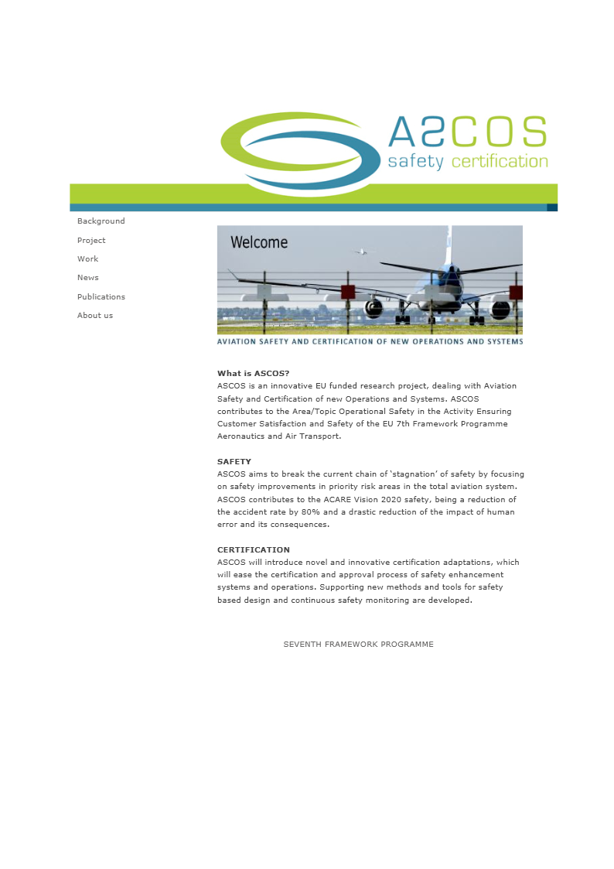

Slide 17

Contact us http://www.ascos-project.eu
ASCOS coordinator:
  Dr. Ir. Lennaert Speijker
  NLR Air Transport Safety Institute
  Email: speijker@nlr-atsi.nl
  Phone : +31 88 511 3654
Scientific Officer:
  Mr. Michael Kyriakopoulos
  European Commission
  DG Research and Innovation – Aeronautics & Air Transport
  Email: michael.kyriakopoulos@ec.europa.eu

Slide 18












Aviation Safety and Certification of new Operations and Systems

