Slide 1
Aviation safety & certification of new operations and systems
WP1 Certification Process
Bernard PAULY (Thales Air Systems)
ASCOS EASA Workshop, 19 April 2013, Cologne

Slide 2
Background
Need for improvement of existing certification processes already identified in FAA Commercial Airplane Certification Process Study
  There is no reliable process to ensure that assumptions made in the design and certification safety assessment are valid for operation and maintenance activities
  Human operators may not be aware of assumptions made in safety assessments, when developing their operations and maintenance procedures
  Aircraft certification standards may not reflect the actual operating environment
Future ’emerging risks’ unknown today may need to be addressed
Current certification processes may take long or turn out infeasible

Slide 3
Total aviation system and the involved stakeholders

Slide 4
WP1 Objectives/ Context/ Inputs
To analyse the existing European certification and rulemaking process and propose potential adaptations to ease certification of safety enhancement systems & operations
The scope is addressing the Total Aviation System with their stakeholders
The considered inputs are not only European (EASA, Eurocontrol…) but also worldwide (ICAO, FAA)
The on-going tasks of WP1 are organised according to the following structure:
  WP1.1 (deliverable D1.1) focused on analysis of the existing regulations and certification processes with identification of potential shortcomings and bottlenecks.
  WP1.2 (deliverable D1.2) dedicated to proposal and assessment of options in terms of “certification” potentially applicable to the different domains (airworthiness, operations, ATM, ….)
  WP1.3 (deliverable D1.3) is focused on the selection and development of the most promising approach

Slide 5
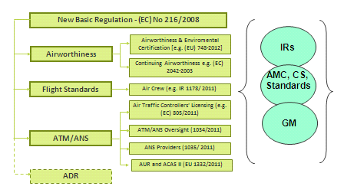
WP1.1 Objectives/ Scope
In the context of the analysis the term shortcoming is used to describe the situation where the regulation is fully implemented but proves to be inadequate.
A bottleneck is “a phenomenon where the performance or capacity of an entire system is limited by a single or limited number of components or resources”. In the context of the analysis the term bottleneck is used to describe the situation where the regulation is not implemented at the expected level.

Slide 6
WP1.1 Overview of the approach
Shortcoming & bottleneck are considered from safety « performance » point of view:
  In terms of consequences: what kind of safety occurrences we need to consider in priority?
  In terms of causes: what kind of regulatory material are involved in selected safety occurrences?
The main assumptions are:
  If the involved regulation by selected safety occurrences is well implemented then this regulation is potentially inappropriate (shortcoming)
  If the involved regulation by selected safety occurrences is not well implemented then there is a potential bottleneck (however to be confirmed by experience)

Slide 7
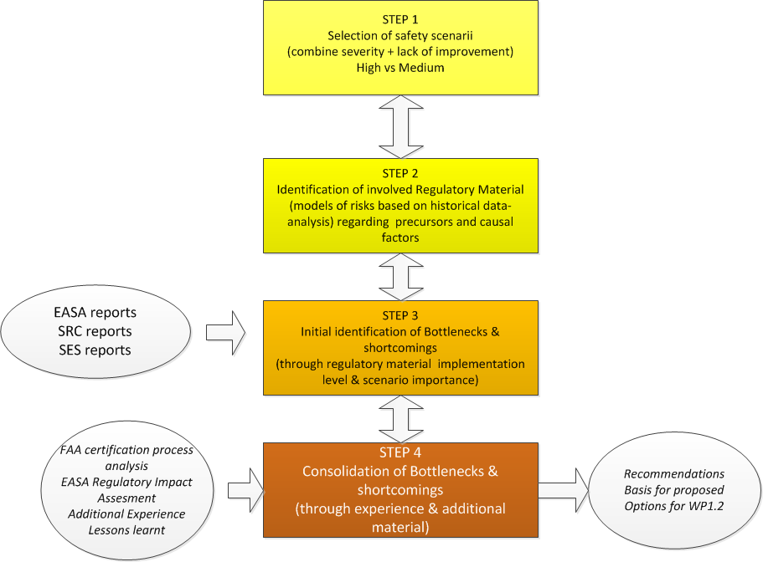
In progress

Slide 8
WP1.1 Analysis existing regulations & certification process
OVERVIEW OF THE APPROACH
STEP 1 Select Safety occurrences scenarios:
  (criteria N° 1) --> consider the severity of safety occurrences: accident, serious incident (severity A),
  (criteria N° 2) --> consider the quantitative evolution of these occurrences (select occurrences categories if there is no improvement for recent years (e.g. number of occurrences absolute or relative),
  select scenarios and related occurrences types in order to assess their importance (high, medium) by combining criteria N°1 and criteria N° 2 according to the following rules:
    Importance of scenario High --> if criteria N°1(OK) AND criteria N°2 (OK),
    Importance of scenario Medium --> if criteria N°1 (OK) OR criteria N°2 (OK),

Slide 9
WP1.1 Analysis existing regulations & certification process
OVERVIEW OF THE APPROACH
STEP 2 Based on selected set of safety occurrences, identify related main involved regulatory material:
  describe safety occurrences in more details,
  identify potential precursors and related causes according to the previous set of selected scenarios and related safety occurrences, [use some inputs from Accident/ Incident models (e.g. CAST, IRP)] in order to highlight involved operations & systems
  consider occurrences figures related to ATM support functions [5] (SRC Annual report 2012)
  consider phases of flight related to safety occurrences scenarios,
  identify level of contribution of each regulatory domain
  The expected outputs should be the list of involved regulatory material consolidated with the related phases of flights, the list of main precursors (and potential causes if possible)

Slide 10
Summary of the approach (step 1 & step 2)

Slide 11
WP1.1 Analysis existing regulations & certification process
(STEP1) USE OF SAFETY OCCURRENCES ANALYSIS (1)
Importance of scenario | Accident/ Incident | Sources | Comments
High | LOC-I (Loss Of Control in Flight) | EASA Annual safety review 2011 | 2002-2011 Highest number of fatal accidents in the decade for CAT (Commercial Air Transport) Figure 6 Annual proportion from all accidents in percentage of LOC-I accidents is increasing from 2008 Figure 7
High | CFIT (Controlled Flight Into Terrain) | EASA Annual safety review 2011 Figure 6 | 2002-2011 Highest number of fatal accidents in the decade for CAT (Commercial Air Transport)
High | RE (Runway Excursion) | EASA Annual safety review 2011 [Figure 8 & Figure 9] | Runway Excursions: no real improvement from 2007 for Accidents (phases of flight landing & take-off) increase of incidents from 2008 (partially due to improvement of safety occurrences reporting): phases of flight landing & taxi

Slide 12
WP1.1 Analysis existing regulations & certification process
(STEP2) ANALYSIS OF PRECURSORS AND CAUSAL FACTORS OF ACCIDENTS/ INCIDENTS (1)
Importance of scenario | Accident/ Incident | Main Precursors -causes (operations & systems)
High | LOC-I (Loss Of Control in Flight) | Pilot induced Icing related events Aircraft System component failure Degraded visual environment IMC (Instrument Meteo Control)
High | CFIT (Controlled Flight Into Terrain) | Pilot trajectory deviation (use incorrect data, wrong altimeter data setting, misjudgement) FMS/ RNAV/ Flight Control Management: * instrument display wrong data * flight director error * autopilot error * airborne altimeter error * Navaid error causes deviation * landing signal error causes deviation (MLS/ ILS) * GBAS error causes deviation ATC Flight trajectory management * inadequate communication with crew * altimeter setting sent by ATC * ATCO coordination

Slide 13
WP1.1 (STEP2) ANALYSIS OF PRECURSORS AND CAUSAL FACTORS OF ACCIDENTS/ INCIDENTS (2)
Importance of scenario | Accident/ Incident | Main Precursors -causes (operations & systems)
High | CFIT (Controlled Flight Into Terrain) | * ATCO instruction (misjudgement of terrain separation) * no radar surveillance or insufficient picture * unclear instruction Route/ procedure design * route/ procedure design * route/ procedure publication Inadequate Flight crew monitoring A/C Ground proximity warning (TAWS/ GPWS) ATCO monitoring +MSAW * safety net MSAW failure * inadequate traffic picture * inadequate transmission of instructions
High | RE (Runway Excursion) | * Aircraft system malfunction (e.g. nose wheel steering or engine malfunction) * Reported wind velocity or runway surface conditions differ from actual conditions; * significant Aquaplaning occurs * A departing aircraft fails to get airborne before end of the runway * A landing aircraft is unable to stop before end of runway (weight, system failure...)

Slide 14
WP1.1 (Step 1) Example of results (scenario “Medium priority”)
Importance of scenario | Accident/ Incident | Sources | Comments
Medium | CLR (aircraft deviation of ATC clearance including Level Bust) | EASA Annual safety review 2011 Figure 11 & Figure 12 SRC Annual report 2012[Figure 14] | Many of these incidents are also categorised as SMI (in the causal chain) An improvement is needed - increased number of safety occurrences not classified in terms of severity.
Medium | RI (Runway Incursion) | EASA Annual safety review 2011 Figure 11 & Figure 12 SRC Annual report 2012 [Figure 14] | Occurrence rate increases in 2010 (although an improvement in 2011: 23 serious in 2011 compared to 22 in 2010 and 62 major in 2011 to 77 in 2010) An improvement is needed - increased number of safety occurrences not classified in terms of severity.
Medium | IS (Inadequate Separation) | SRC Annual report 2012 Figure 14 | An improvement is needed - increased number of safety occurrences not classified in terms of severity.

Slide 15
WP1.1 (STEP2) Example of ANALYSIS OF PRECURSORS AND CAUSAL FACTORS OF ACCIDENTS/ INCIDENTS (scenario “Medium priority”)
Importance of scenario | Accident/ Incident | Main Precursors -causes (operations & systems)
Medium | CLR (aircraft deviation of ATC clearance including Level Bust) | Main precursor: Crew/ Aircraft induced conflict * Levels busts causes - inadequate communication of level/ height to pilot - pilot handling error - altimeter setting error - aircraft technical failure - ACAS RA cause - weather induced level bust * aircraft deviation causes (lateral, speed, vertical speed) - pilot induced (misunderstood ATC instruction, failure to follow ATC - instruction or ATC procedures, emergency situation) - wake induced deviation - aircraft induced deviation (incorrect AIS data, technical failure)
Medium | RI (Runway Incursion) | ATC instigated Runway Entry incursion * failure to balance operational airport capacity/ demand * tower (runway) failure to balance arrivals or departures * AMAN/ DMAN insufficient spacing * failure in managing sequences * inadequate instruction to pilot * inadequate communication to pilot (loss, failure)

Slide 16
WP1.1 (STEP2) Example of ANALYSIS OF PRECURSORS AND CAUSAL FACTORS OF ACCIDENTS/ INCIDENTS (scenario “Medium priority”)
Importance of scenario | Accident/ Incident | Main Precursors -causes (operations & systems)
Medium | RI (Runway Incursion) | * insufficient (use of) ground surveillance * runway status information inadequate * inadequate coordination between tower & apron Non ATC Runway Entry incursion Animal/ Person Runway incursion Premature landing incursion * ATC landing procedures (insufficient spacing, clearance error, inadequate communication with pilot) * Landing without clearance (pilot takes clearance of other aircraft) * Landing on wrong runway (landings aids failure) Premature Take-Off incursion * use of closed runway * failure to recognize availability of runway * inadequate communication with pilot * failure to follow take-off procedures
Medium | IS (Inadequate Separation) | Main precursor: Planned conflict * ineffective traffic planning or coordination * inadequate surveillance picture * incorrect trajectory information (planning data)

Slide 17
WP1.1 Analysis existing regulations & certification process
OVERVIEW OF THE APPROACH
STEP 3 Use of the degree of implementation of regulatory material: consolidate the identification of shortcomings and bottlenecks by performing a cross analysis with the degree of implementation in Europe regarding the involved regulatory materials:
  Very High Priority (shortcoming & bottleneck) if:
    The safety occurrences scenarios induced in the scope of the regulatory domain are high (accident/ incidents severity A),
    The interaction with the other regulatory domains is very important in the analysis of safety occurrences scenarios.
    The identified regulatory area is not implemented at the expected level (whatever the reason).

Slide 18
WP1.1 Analysis existing regulations & certification process
OVERVIEW OF THE APPROACH
STEP 3 Use of the degree of implementation of regulatory material:
  High Priority (shortcoming) if:
    The safety occurrences scenarios induced in the scope of the regulatory domain are high (accident/ incidents severity A),
    The interaction with the other regulatory domains is important in the analysis of safety occurrences scenarios 3. (need of high degree of harmonisation)
    The degree of regulation application is at the expected level,
  Medium Priority (bottleneck) if:
    The safety occurrences scenarios induced in the scope of the regulatory domain are medium (not explicitly related to safety occurrences (accident/ incidents severity A).
    The interaction with the other regulatory domains is less important in the analysis of safety occurrences scenarios3.
    The identified regulatory area is not implemented at the expected level (whatever the reason).
  Satisfactory if:
    The safety occurrences scenarios induced in the scope of the regulatory domain are medium (not explicitly related to safety occurrences (accident/ incidents severity A).
    The degree of regulation application is at the expected level,

Slide 19
WP1.1 (STEP3) Use of Degree of implementation of Regulatory Material- initial classification
Level of Safety risks
[safety occurrences scenarios combined with interactions
with other regulatory domains

Slide 20
ASCOS Technical Task Meetings
WP1.1 (Step 4) initial recommendations (shortcomings vs bottlenecks)
Recommendation how to proceed | Rationale
In many cases human error can be identified as direct cause of the accident both when piloting as maintenance are taken into consideration. Elaboration of design techniques in area of piloting as well as maintenance better addressing the avoiding of error-prone solutions. | LOC-I (Loss of Control in Flight) Nearly alarming trend in change of number of fatal accidents in this category. Very often leads to severe fatal accidents.
Human error is dominating casual factor in CFIT accidents. Besides improved methodology of pilot training it is also crucial to develop less error-prone solutions in terms of human –machine interface to minimise the risk of loss situational awareness due to misreading flight instrument indication. | CFIT (Controlled Flight Into Terrain) One of the critical accident types. However the number of CFIT accident significantly decreased in recent years. It represents optimistic trend.
Similarly to above the runway excursion related accidents and incidents’ causes lies in human errors. Lack of procedures eliminating error-prone solutions. Elaboration of tools ensuring proper and full execution of ICAO Annex 14 SARPs at Aerodromes. | RE (Runway Excursion) Poor improvement in recent years. Increased air traffic at main airports can lead to higher risk related to RE accidents.

Slide 21
WP1.1 (Step 4) initial recommendations (shortcomings vs bottlenecks)
Recommendation how to proceed | Rationale
Human error is dominating casual factor in UAP accidents as well. Besides improved methodology of pilot training it is also crucial to develop less error-prone solutions in terms of human –machine interface to minimise the risk of loss situational awareness due to misreading flight instrument indication.* | UAP (Unauthorised penetration of airspace or airspace infringementsConsiderable increase in 2011. Potential risk due to growing air traffic.
Similarly to UAP, SMI also CLR type accidents results mainly from ATCO errors. There is a necessity of elaboration of air traffic management techniques and procedures addressing more efficient communication and data transfer as well as avoiding of error-prone solutions.* | SMI (Separation Minima Infringement) Year-to-year increase in almost all recent years. High statistical severity of SMI accidents. Worrying trend.
 | CLR (aircraft deviation of ATC clearance including Level Bust) Similarly as SMI category accidents. There is a need for improvement due to increased number of safety occurrences not classified in terms of severity

Slide 22
WP1.1 (Step 4) initial recommendations (shortcomings vs bottlenecks)
ASCOS Technical Task Meetings
Recommendation how to proceed | Rationale
Similarly to UAP and SMI RI type accidents results mainly from ATCO errors. There is a necessity of elaboration of air traffic management techniques and procedures addressing more efficient communication and data transfer as well as avoiding of error-prone solutions. Elaboration of tools ensuring proper and full execution of ICAO Annex 14 SARPs at Aerodromes (for RI Runway incursion) | RI (Runway Incursion) The situation is more or less stable. Nevertheless increased traffic at main airports leads to the conclusion that it is also high risk area.
 | IS (Inadequate Separation) The situation is more or less stable. Nevertheless increased traffic at main airports leads to the conclusion that it is also high risk area.

Slide 23
WP1.2 Identify and select option(s) of an adaptation of regulatory/ certification process
Based on WP1.1 recommendations, WP1.2 identifies following main options that have been evaluated per domain (Authorities/ Operations/ ATM/ Industry….):
  1 Integrate all domains within the Authority / total concentration of expertise in the Authority
  2 Change to “Performance based” i.l.o. “Compliance based”, or the other way around
  3 Abolish all certification by Authorities and transform into a voluntary compliance with a certain safety level
  4 Make more use of competent ( certified ) entities to supplement the workforce of the authorities
  5 Certify the applicants instead of their products
  6 Use of Proof of Concept approach
  7 Do not change anything but enforce existing rules / improve existing processes
  8 Cross-domain fertilisation

Slide 24
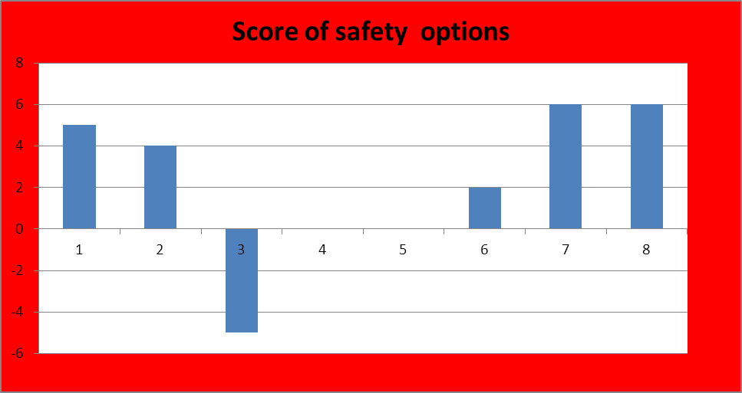
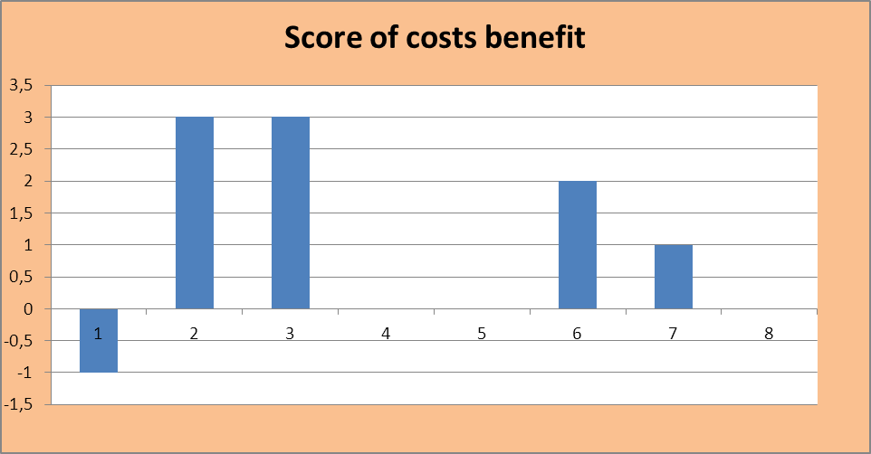
WP1.2 Score of options according to safety/ costs and a set of secondary criteria
Secondary criteria:
Throughput time
stimulation of innovation
Required expertise
Bureaucracy
Interoperability between
  domains
Harmonisation of
  standardisation
  …….

Slide 25
WP1.2 Score of options according to safety/ costs and a set of secondary criteria
According to safety & costs criteria the following options are further investigated by refining scoring with secondary criteria for the different domains (Authorities, Ops, ATM, Industry….)
Option 2 Change to “Performance based” i.l.o. “Compliance based”,
  Option 6 Use of Proof of Concept approach
  Option 7 Do not change anything but enforce existing rules / improve existing processes

Slide 26
Conclusion: recommendations of WP1.1 & WP1.2 for WP1.3 (development of the selected approach)
minimise unnecessary change, recognising the good approaches already in place
provide a generic certification framework encompassing the total aviation system (TAS)
use a common language across all domains based on safety argument concepts (e.g. argument-based as described by OPENCOSS), but allowing flexibility to accommodate a variety of approaches across domains
provide rigorous management of interfaces, both between domains and between the TAS and its environment – key aim is to ensure that safety issues (e.g. assumptions, restrictions) are properly addressed and not lost at interfaces
allow, within each domain, certification approach to evolve from the current approach
  keeping the existing approach where no change is required
  learning lessons from other domains where this gives improvement
  ensure that bottlenecks and shortcomings (as identified by WP1.1 and WP1.2) are addressed by the proposed approach

Slide 27
Conclusion: recommendations of WP1.1 & WP1.2 for WP1.3 (development of the selected approach)
promote flexibility within each domain to allow introduction of new technologies or procedures
harmonise approaches between domains where this is advantageous or necessary
simplify certification process where there are:
  demonstrable benefits and
  no loss of confidence in the assurance of safety
champion / reinforce existing techniques where they are appropriate but not consistently applied
provide a mechanism for identification and resolution of further bottlenecks and shortcomings

Slide 28












Thanks for your attention
Aviation Safety and Certification of new Operations and Systems

