Slide 1
Framework safety performance indicators
19 April 2013

Slide 2
Main objective
Define a framework of Safety Performance Indicators for the total aviation system

Slide 3
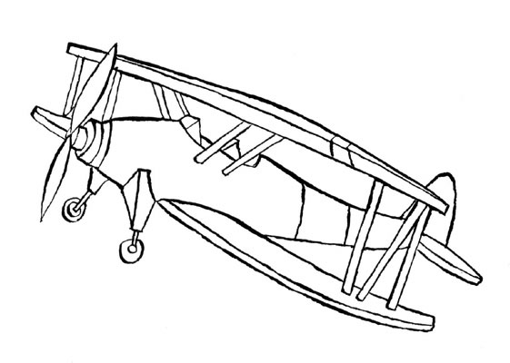
What is a Safety Performance Indicator?
Safety is freedom from unacceptable risk
Risk is a combination of the frequency and severity of harm

Slide 4
What is a safety performance indicator
An indicator of the likelihood of an aircraft accident.

Slide 5
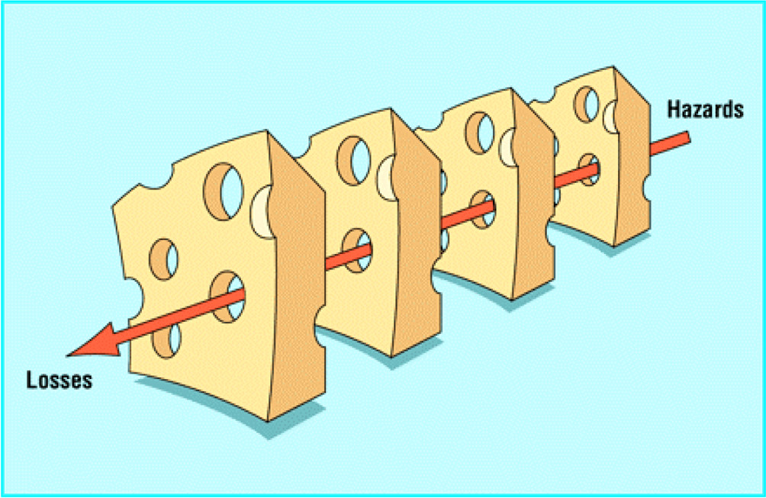
Reason’s model
Defence in depth

Slide 6
Two ways to estimate accident probability
Count the number of barrier breaches over a period of time
Simple but needs historical data (barrier breaches) and is not very informative
Assess the number and size of the holes in the barriers
More work and requires in-depth knowledge of the system

Slide 7
Barrier analysis

Slide 8
Types of barriers
Physical
Non-physical
Passive
Active
Prevent marshalling of energy
Reduce amount of energy
Prevent release of energy
Modify rate of release
Separate energy in space or time
Separate energy by a material barrier
Modify contact surface
Strengthen the structure
Counter continuation of damage
Long term rehabilitative measures
Man
Technology
Organisation
Prevention of conflict
Resolution of conflict
Recovery from conflict

Slide 9
Types of barriers
Physical
Non-physical
Passive
Active
Prevent marshalling of energy
Reduce amount of energy
Prevent release of energy
Modify rate of release
Separate energy in space or time
Separate energy by a material barrier
Modify contact surface
Strengthen the structure
Counter continuation of damage
Long term rehabilitative measures
Man
Technology
Organisation
Prevention of conflict
Resolution of conflict
Recovery from conflict

Slide 10
System of
organisations
Organisation
Individual
Component

Slide 11
System of organisations
Training
Load
handling
Maintenance
Design &
Construct
Operations
ATC
Rules &
Certification
Meteo
Emergency
response

Slide 12
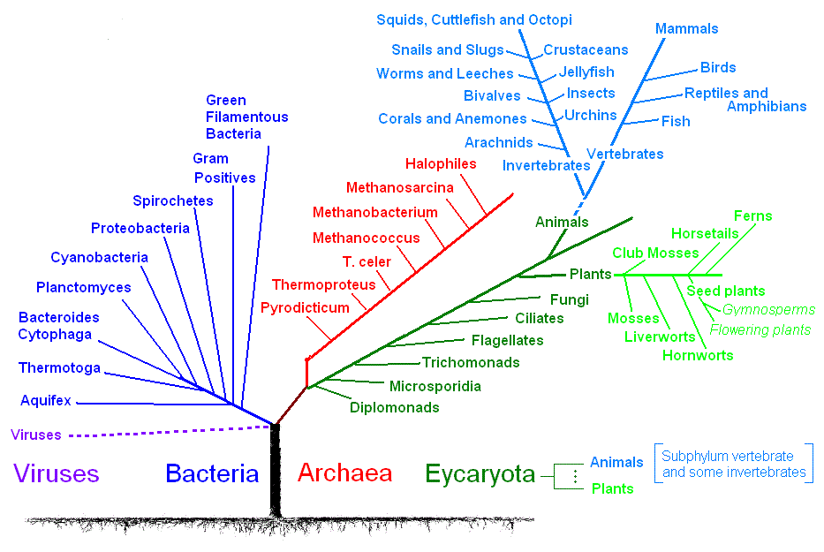
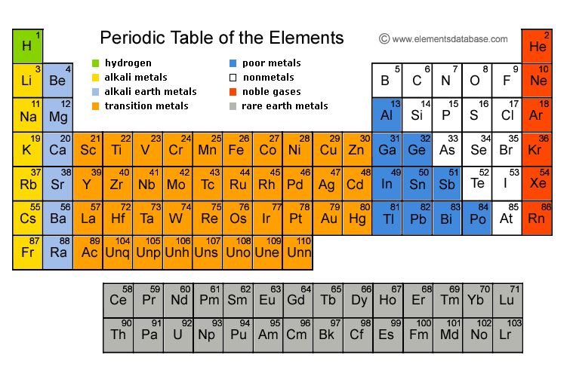
For each type of barrier
Framework description
Analysis
Selection of performance indicators including justification

Slide 13
Component
ADREP 2000/ECCAIRS classification system
Aircraft components and systems (ATA chapter)
ATM components and system
ATM communications systems
ATM navigation approach aids
ATM surveillance systems
ATM data processing system
ATM power supply
ATC wind shear warning system
ATC aerodrome warning system
ATC minimum safe altitude system
ATC short term conflict alerting system
Aerodrome
Runway
Taxiway
Apron/ramp
Aerodrome structures
Aerodrome lighting
Aerodrome marking
Aerodrome equipment/facilities
Meteorological service equipment

Slide 14
Analysis
General requirements for Performance Indicators
Quantifiable
Representative to what is to be measured.
Provide minimum variability when measuring the same conditions.
Sensitive to change in environmental or behavioural conditions.
Cost or effort of obtaining information is acceptable.
Comprehendible.

Slide 15
Correlation and causation

Slide 16
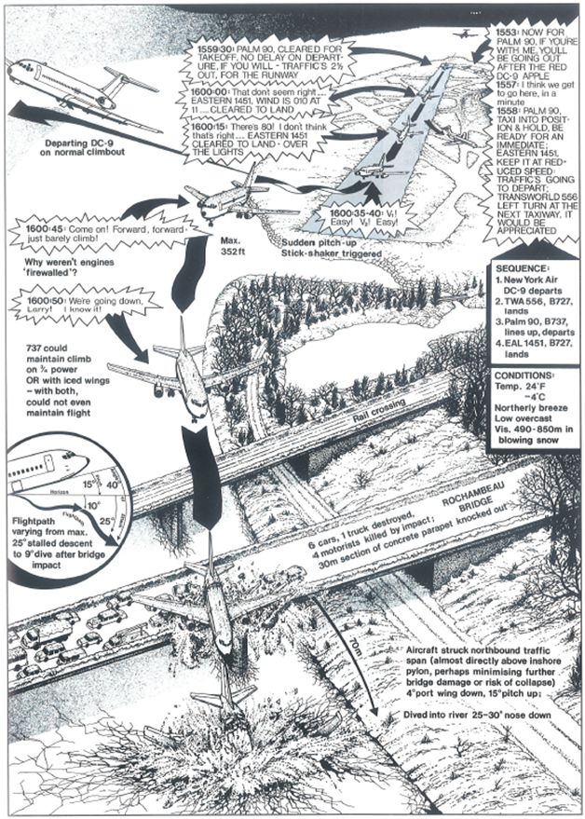
Accident scenarios logically link the hazards and barrier failures to the final outcome

Slide 17
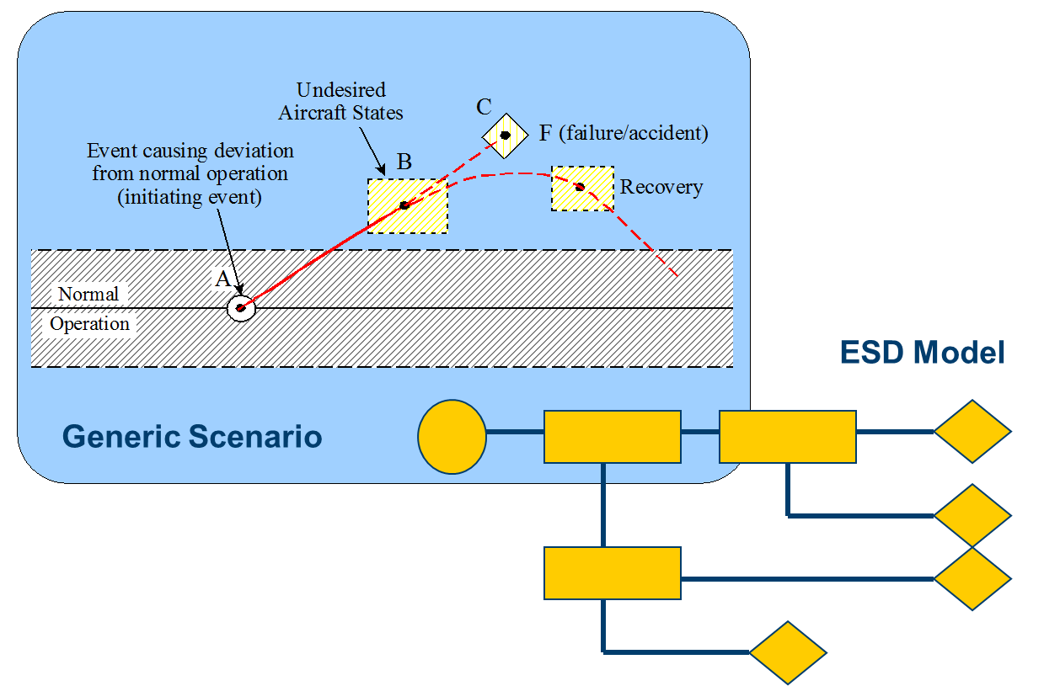

Slide 18
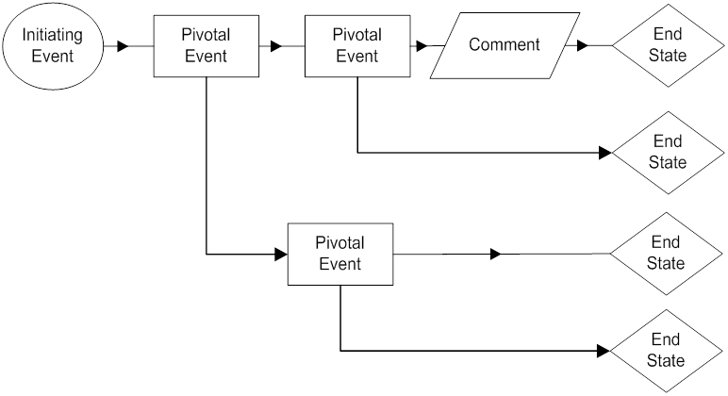
Event Sequence Diagram

Slide 19
‘Typical’ accident: Take off with contaminated wing
Date | Aircraft type | Location | Weather
13/01/82 | Boeing 737-200 | Washington, D.C. USA | -4 deg. C. Heavy snowfall.
05/02/85 | Douglas DC-9-15 | Philadelphia, Pennsylvania, USA | -2 deg. C. Ice pellets, snow.
15/10/87 | Douglas DC-9-14 | Denver, Colorado, USA | -2 deg. C. Moderate snow.
10/03/89 | Fokker F-28 | Dryden, Ontario, Canada | + 2 deg. C. Locally heavy snow.
17/02/91 | Douglas DC-9-15 | Cleveland, Ohio, USA | -5 deg. C. Light snow.
22/03/92 | Fokker F-28 | Flushing, New York, USA | 0 deg. C. Drifting snow.
05/03/93 | Fokker 100 | Skopje, Macedonia. | 0 deg. C. Moderate snowfall.

Slide 21
Events are detailed in Fault Trees
Event Sequence
Diagram
Fault Tree

Slide 22
Connecting the SPIs to the model elements allows combination of indicators into single risk figure for different types of outcomes:
Runway excursion
Mid-air collision
Controlled Flight Into Terrain
Loss of control in flight
Ground collisions

Slide 23
Aviation Safety and Certification of new Operations and Systems

