Slide 1
continuous safety monitoring
19 April 2013

Slide 2
Main objective
Develop a process and associated tools for Continuous Safety Monitoring

Slide 3
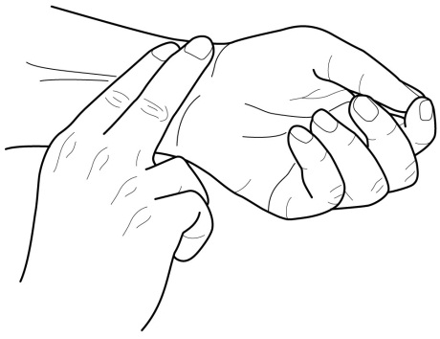
What is continous safety monitoring?
‘Real time’ assessment of the likelihood of an accident.

Slide 4
Current practice: retrospective event monitoring.

Slide 5
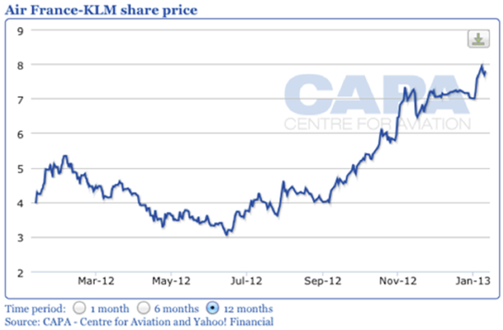
Step 1: From retrospective event monitoring to ‘real time’ event monitoring
This is like company stock prices that are updated continuously.

Slide 6
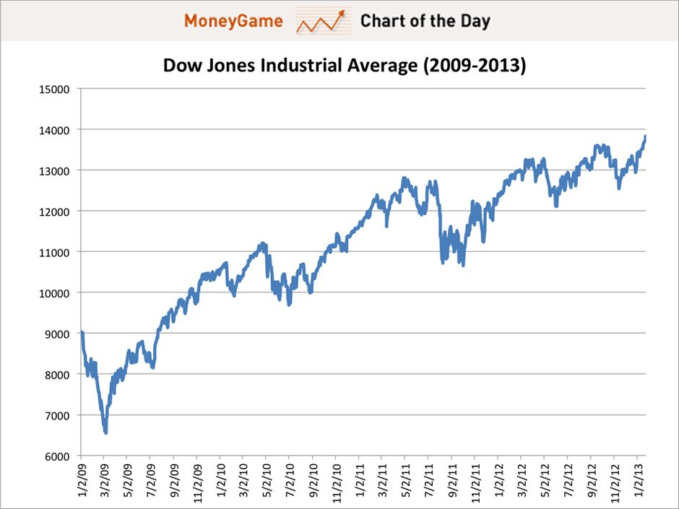
Step 2: From real time event monitoring to real time safety monitoring
This is like going from individual stock prices to an index

Slide 7
Baseline risk picture for the total aviation system combines events into risk
Based on CATS and Eurocontrol IRP

Slide 8
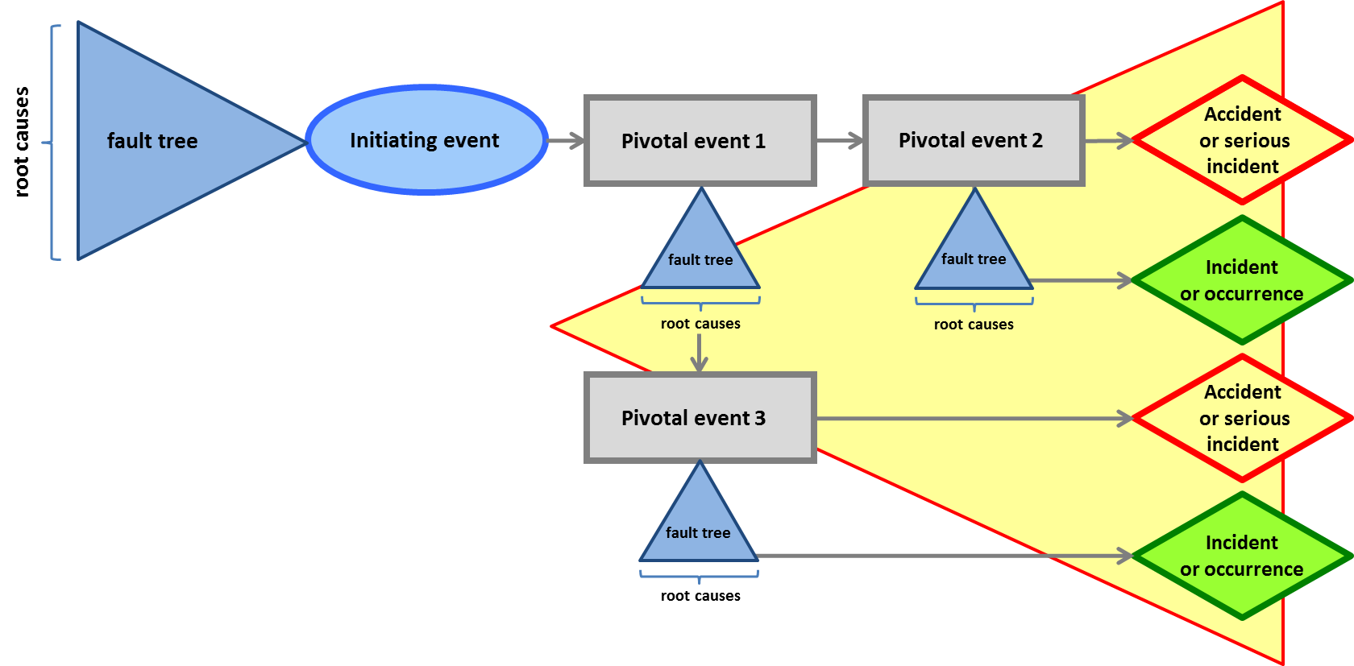
Risk picture

Slide 9
ESD | Initiating event
1 | Aircraft system failure during take-off
2 | ATC related event during take-off
3 | Aircraft directional control by flight crew inappropriate during take-off
4 | Aircraft directional control related system failure during take-off
5 | Incorrect configuration during take-off
6 | Aircraft takes off with contaminated wing
8 | Aircraft encounters wind shear after rotation
9 | Single engine failure during take-off
10 | Pitch control problem during take-off
11 | Fire, smoke, fumes onboard aircraft
12 | Flight crew member spatially disorientated
13 | Flight control system failure
14 | Flight crew incapacitation
15 | Ice accretion on aircraft in flight
16 | Airspeed, altitude or attitude display failure
17 | Aircraft encounters thunderstorm, turbulence, or wake vortex
18 | Single engine failure in flight
19 | Unstable approach
21 | Aircraft weight and balance outside limits during approach
23 | Aircraft encounters wind shear during approach or landing
25 | Aircraft handling by flight crew inappropriate during flare
26 | Aircraft handling by flight crew inappropriate during landing roll
27 | Aircraft directional control related systems failure during landing roll
31 | Aircraft are positioned on collision course in flight
32 | Runway incursion
33 | Cracks in aircraft pressure cabin
35 | TAWS alert
36 | Conflict on taxiway or apron
38 | Loss of control due to poor airmanship
Initiating events of ASCOS risk picture

Slide 10
Risk picture is currently quantified from historic data

Slide 11
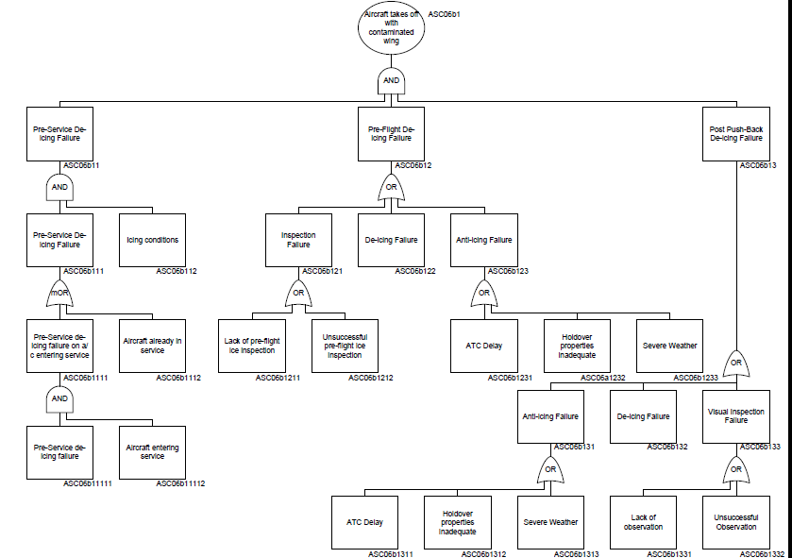

Slide 12
Continuous monitoring
ASCOS will develop tools that support real time event and safety monitoring.

Slide 14
Aviation Safety and Certification of new Operations and Systems

